Slide 1
Home Finder
Graduation Project 2023 - 2024
Supervised By Dr. Nora Shoaib
Dr. Hoda El-Batrawy

Slide 2
Working Team Name
Mohamed Khaled El-Kady
Ahmed Sabry Sommat
Aya Fathy Mohamed
Salma Mahmoud Abo Basha
Aya Hany Mohamed
Ibrahim Ahmed Ibrahim
Mohamed Mahrous Elwan
Ayman Gaber Gamal
Rewan Adel Mahrous
Aya Mostafa Nada

Slide 3
Table of Contents
Abstract
Introduction
Problem Statement
Related Work
Requirements
6
1
2
3
4
5
Methodology Approach
Time Plan
Implementation
Machine Learning Models
Conclusion
Current Progress
7
8
9
10
11
12
13
Future Work
References

Slide 4
Abstract
In today's fast-changing housing market, predicting prices and connecting buyers and sellers effectively are big challenges. This project introduces an app that uses machine learning for helping users to reduce the process of exploitation by brokers and overpricing of real estates.
Therefore, our app helps people buy, sell, and rent houses. It also gives personalized price predictions for buyers and helpful advice for sellers by looking at past data and important property details, our app helps users make smart choices when dealing with housing.

Slide 5
Introduction
The process of buying, selling, or renting a house can be overwhelming, riddled with uncertainties and complexities. Navigating price fluctuations, finding the right property, and securing a fair deal require significant time, effort, and expert knowledge. Our innovative app aims to streamline this process, empowering users with valuable tools and data-driven insights.
Our platform redefines real estate that seamlessly connects buyers, sellers, and agents that integrate features like user-friendly registration, advanced property listings including machine learning for price prediction.
Additionally, we empower users with a messaging system for direct communication between buyer and sellers and integrated rating and review functionalities.

Slide 6

Problem Statement
In recent years, Egypt has witnessed a high and unstable increase in prices, which has led to confusion among buyers and tenants.

Slide 7
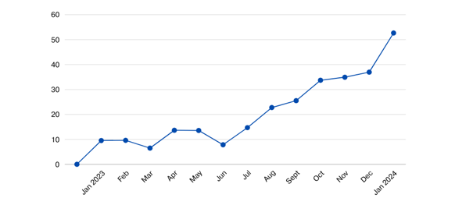
Problem Statement
Monthly Price Rate
Over the past year, the percentage of increase in January 2023 was 9.54 % and continued to increase until it reached 52.67% in January 2024, with an increase rate over the entire year of 43.13%.
Product : Real Estate Prices Rate
Year : 2023 - 2024
Total : 43.13%

Slide 8
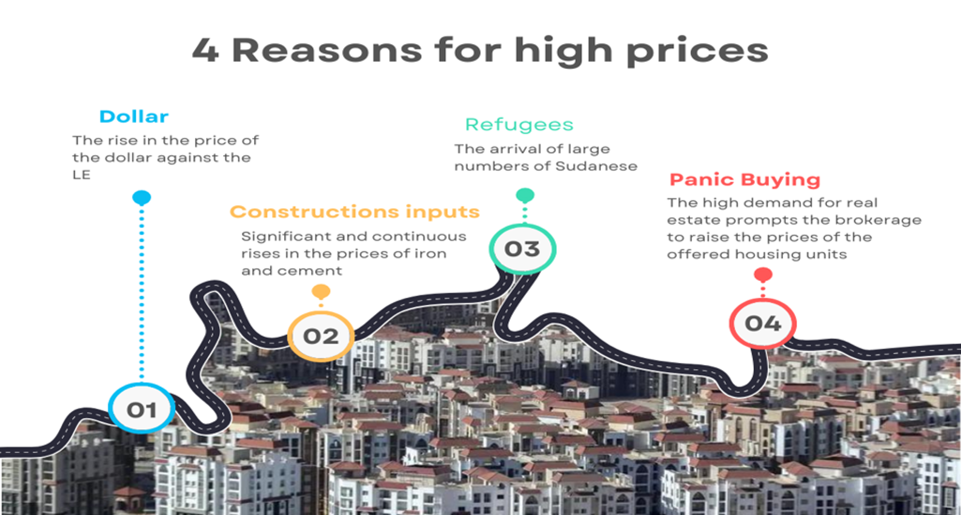

Slide 9

Problem Statement
The core reason we work on: The arrival of refugees, and because of the high dollar, causes an increase in demand for real estate with 42%.
which leads to a discrepancy in prices and provides an opportunity for merchants to exploit the situation.

Slide 10

Problem Solve
Because of the problems we mentioned and also The exploitation of economic conditions and refugees by some brokers. which led to a disparity in the prices offered,
We have solved these problems by machine learning model THAT predict the prices of housing units in order to reduce the fraud of brokers and offer housing units at prices close to reality.

Slide 11
Requirements

Slide 12
Non-Functional Requirements
Performance
Page load time - All pages should load within 2 seconds for 95% of users on broadband connections.
Reliability
Regular backups should be performed.

Slide 13
Functional Requirements
Accounts and Profiles
Reviews
User registration and profiles.
User authentication (email, social media).
User reviews and ratings for properties and agents.
Search and Filtering
Notifications
Search by location, price, size, amenities, etc.
Advanced filtering options based on specific criteria.
Saved searches and property recommendations.
Multilingual Support
Messaging
Offer website content and support in Arabic, English.
Direct messaging between buyers, sellers and Owners.
Machine Learning
Estimate property value based on historical data and market trends.

Slide 14
Related Work

Slide 15
Related Work
Inkinen et al
Trulia is an American real estate marketplace founded in 2005.
A visual representation of transit times is displayed on a geographic map and this provides the ability to see how far one can travel from any given property in a given time period.
Trulia offers a variety of services to realtors home buyers, sellers, and renters can find information about a specific neighborhood and the feature provides original photos, reviews from residents, and facts about each area.

Slide 16
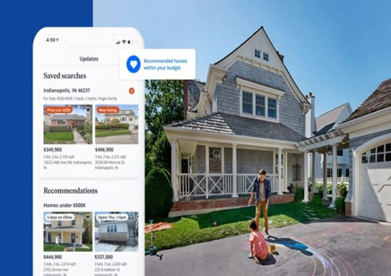
Related Work
Barton et al (Zillow)
An American technology real estate market company founded in 2006.
They launched features that allow users to post homes for sale and set a price. They released a tool for tenants to submit a credit check and eviction history report to their landlords.
It offers many features, including home value estimates, changes in the value of each home over a specific time frame, prices of similar homes in the area, and provides basic information about the home such as square footage and number of rooms.

Slide 17
Related Work
Bharathi et al
Forecasting analysis is one of the many methods that can be used to determine the price of a house, which can be determined according to location, size, city, country, tax rules, economic cycle, population, movement, interest rate, and many other factors that affect demand to predict house prices.
published research in 2019 about predicting housing price.
There is regression based forecasting and they use this model because Provides insight into how tax rebates and shifts in the local economy
A study conducted on the city of Savannah, Georgia using a hedonic pricing model shows that the standard price of homes is positively related to the number of bathrooms, bedrooms, and fireplaces.

Slide 18
Methodology Approach

Slide 19
We are using Agile methodology, breaking the project into iterative sprints focused on specific functionalities. Regular meetings will ensure continuous feedback and adaptation, This approach fosters collaboration, flexibility, and rapid delivery, allowing us to incrementally build and refine the application while maintaining a clear focus on project goals.

Slide 20
Timeline
Project Planning
Databases
Design
Prototype
Development
Testing
Deployment
Launch and Monitoring
Research and Requirements Gathering
1 - 3 Week
3 - 7 Week
10 - 15 Week
7 - 10 Week
15 - 18 Week
18 - 26 Week
26 - 28 Week
28 - 30 Week
Indefinite

Slide 21
Implementation

Slide 22
Implementation
Front-End
Web
Programming Language : JavaScript.
UI Styling : HTML/CSS (Standard technologies for structuring content and styling).
Back-End
API : Node.js with Express framework for RESTful API development.
Database : Cloud-based NoSQL database (MongoDB) for scaling and flexibility.

Slide 23
Implementation
Front-End
Mobile Android
Programming Language : Kotlin (Officially supported by Google for Android development , interoperable with Java).
UI Framework : Android SDK (Provides powerful tools and libraries for building user-friendly mobile applications).
Architecture : MVVM (Model-View-ViewModel) for modular and maintainable code.
Networking : Retrofit (Widely used library for efficient API communication).

Slide 24
Implementation
Front-End
Mobile iOS
Programming Language : Dart.
Framework : Flutter (Cross Platform Application).
Common Libraries :
Shared Preferences to save data on mobile cash
Getx for state management
Pretty dio logger & Dio better for handling http calls and internet calls
Star Rating to show every user rating for the houses in app
Cupertino : A handy tool for creating iOS-style designs in Flutter. It simplifies the process by encapsulating commonly used iOS-specific components, like default fonts and scrolling physics.

Slide 25
Machine Learning Models

Slide 26
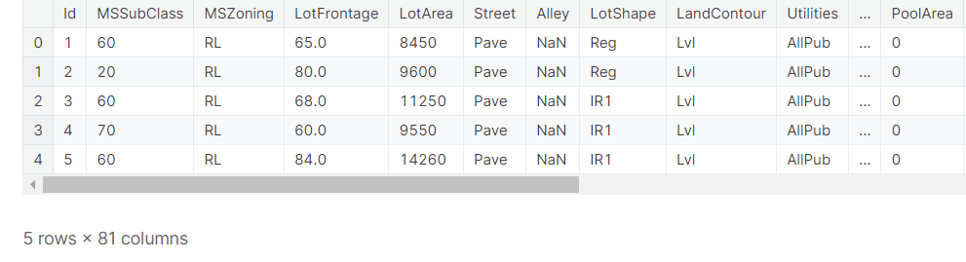
Used algorithm in machine learning
About Dataset
Our Dataset talk about house prices. With 79 explanatory variables describing (almost) every aspect of residential homes such as : the building class, neighborhood, electrical system ,etc.

Slide 27
Aims & Objectives
Data Preprocessing
The Main aim is to Train the Machine Learning to predict House price based on based on different metrics using convolution neural network
We categorize the features depending on their datatype (int, float, object) and then calculate the number of them.
Importing Libraries and Dataset
Metrics
Pandas
Matplotlib
Seaborn
Root Mean Squared error
Mean squared error
Mean absolute error

Slide 28
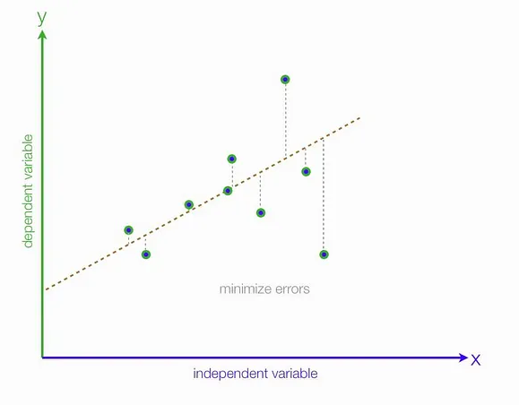
Machine learning models
Ridge regression
Linear regression
Supported vector machine (SVM)
Linear regression models assume that the relationship between a dependent continuous variable Y and one or more explanatory (independent) variables X is linear (that is, a straight line). It’s used to predict values within a continuous range (e.g. sales, price) rather than trying to classify them into categories (e.g. cat, dog).

Slide 29
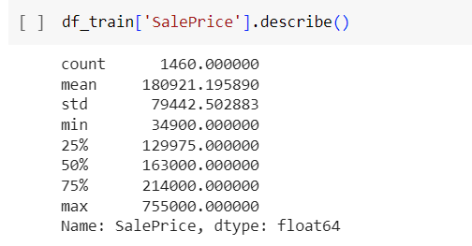
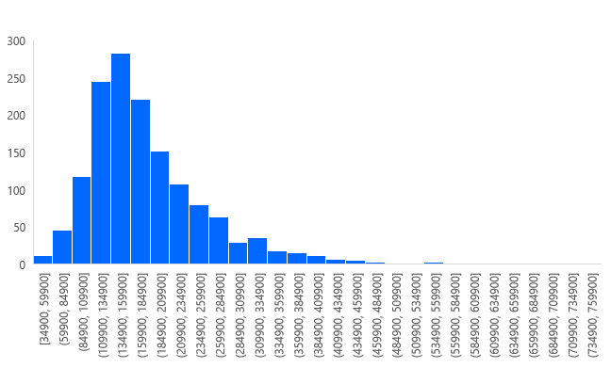
Sale Price

Slide 30
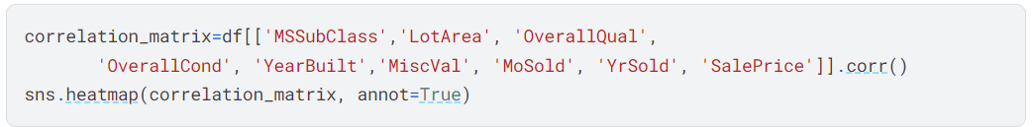
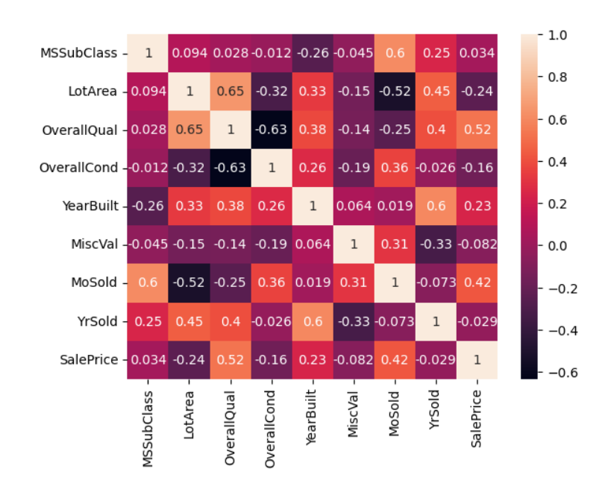
Let’s have a more general view on the top 8 correlated features with the sale price:
Observations
1 represents the Maximum correlation
Negative values represents the very low correlation
positive values Represents the Maximum correlation
Lighter color shows the High Correlation and Darker color shows the Lower correlation

Slide 31
Current Progress

Slide 32
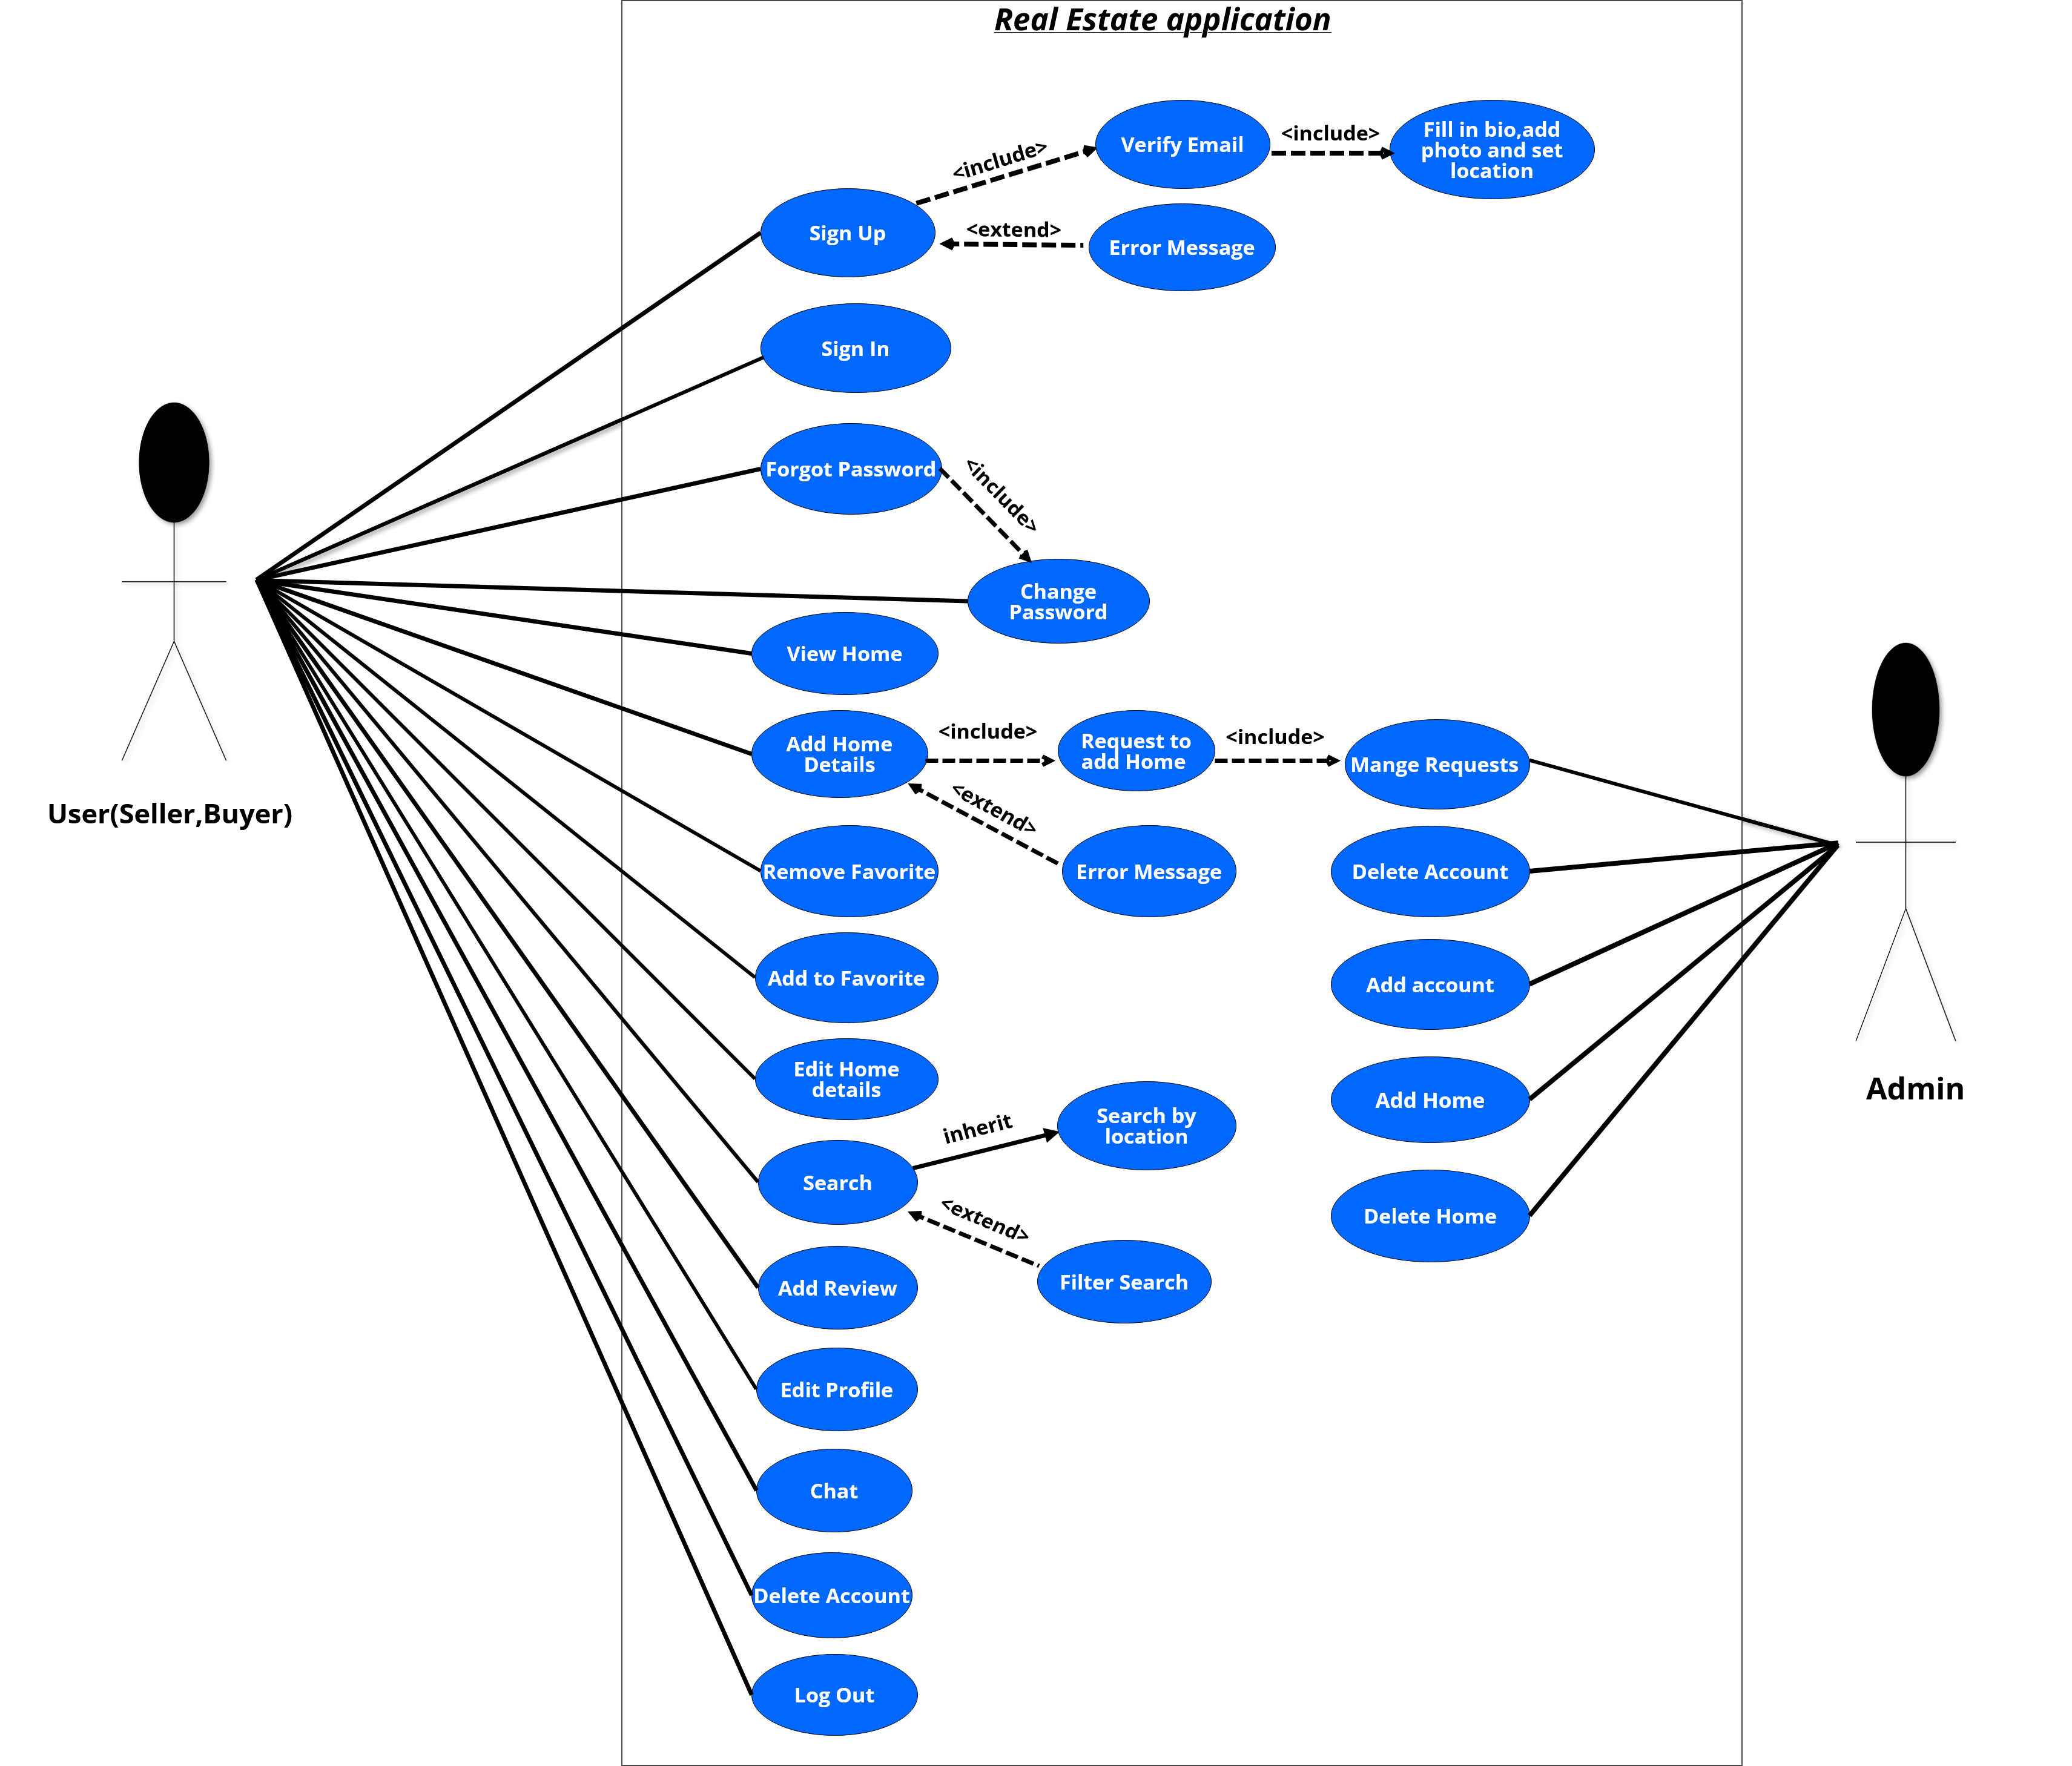
Use Case of our app (Home Finder)

Slide 33
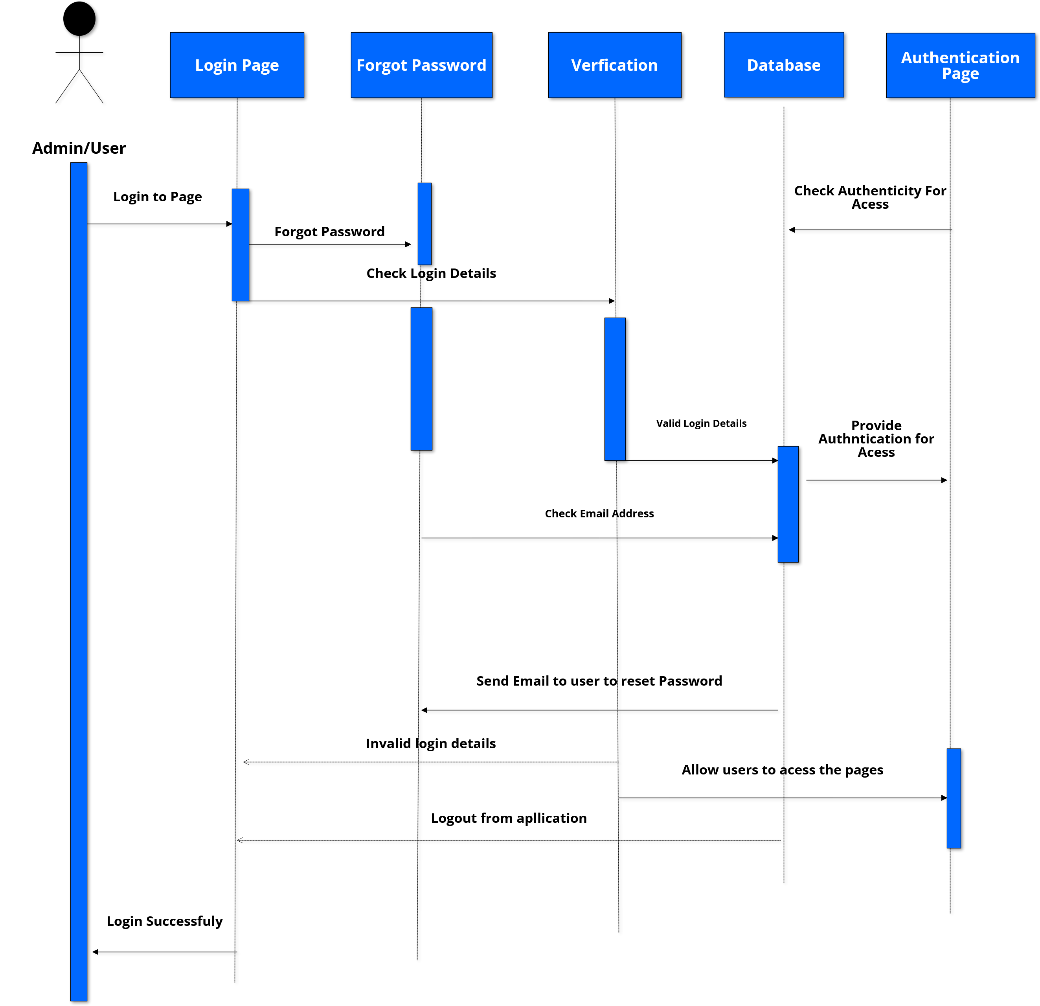
System Sequence Diagram

Slide 34
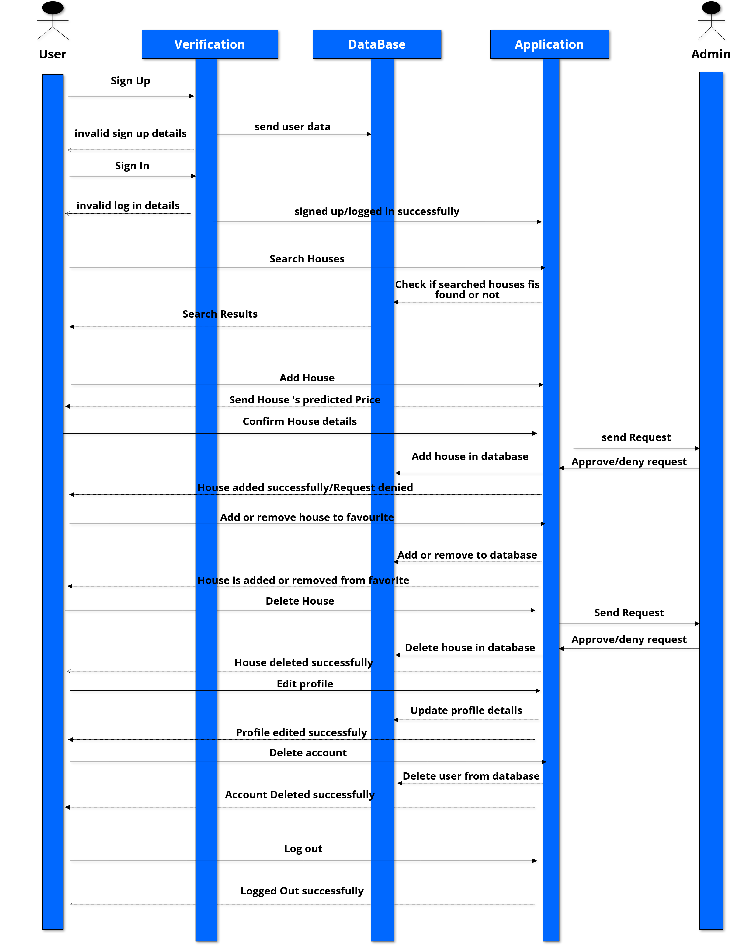
System Sequence Diagram

Slide 35
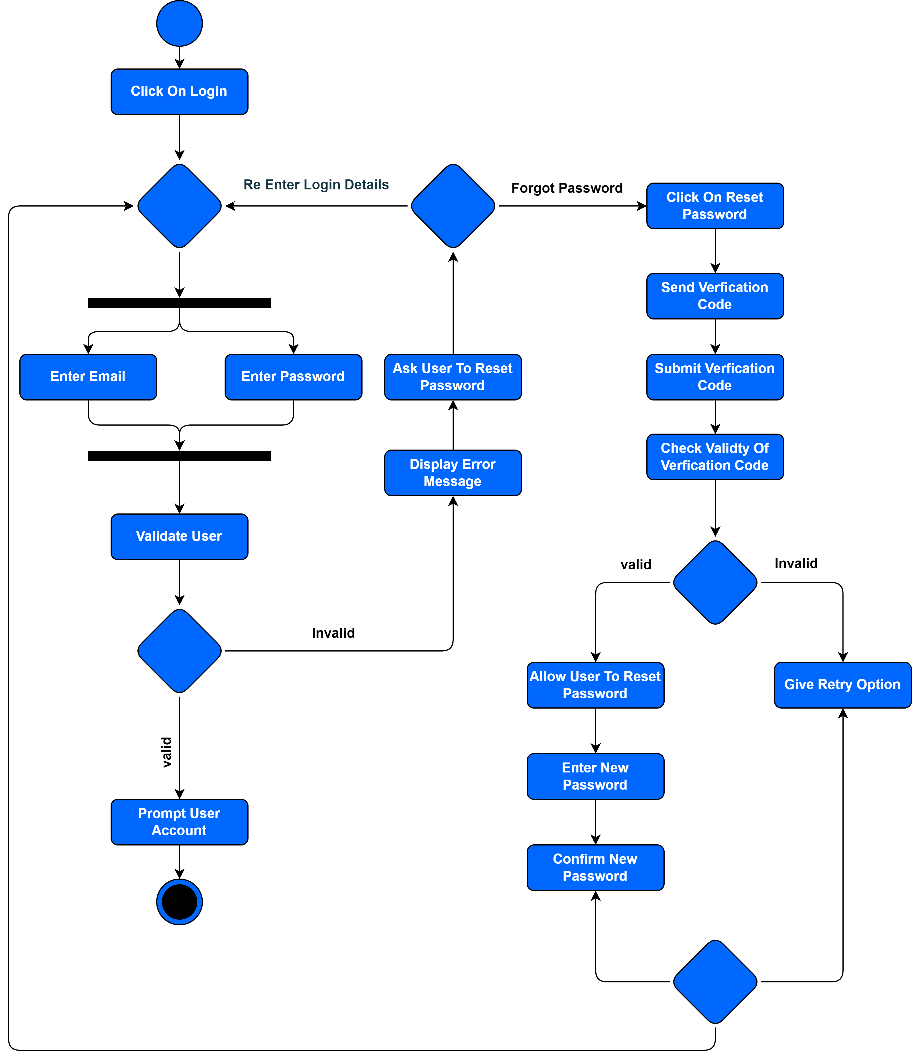
Activity Diagram (Login)

Slide 36
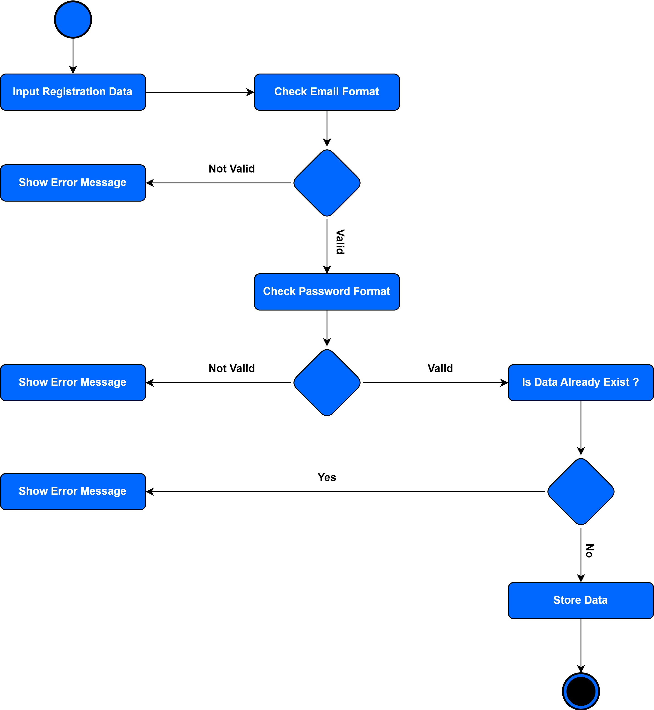
Activity Diagram
(Registration)

Slide 37
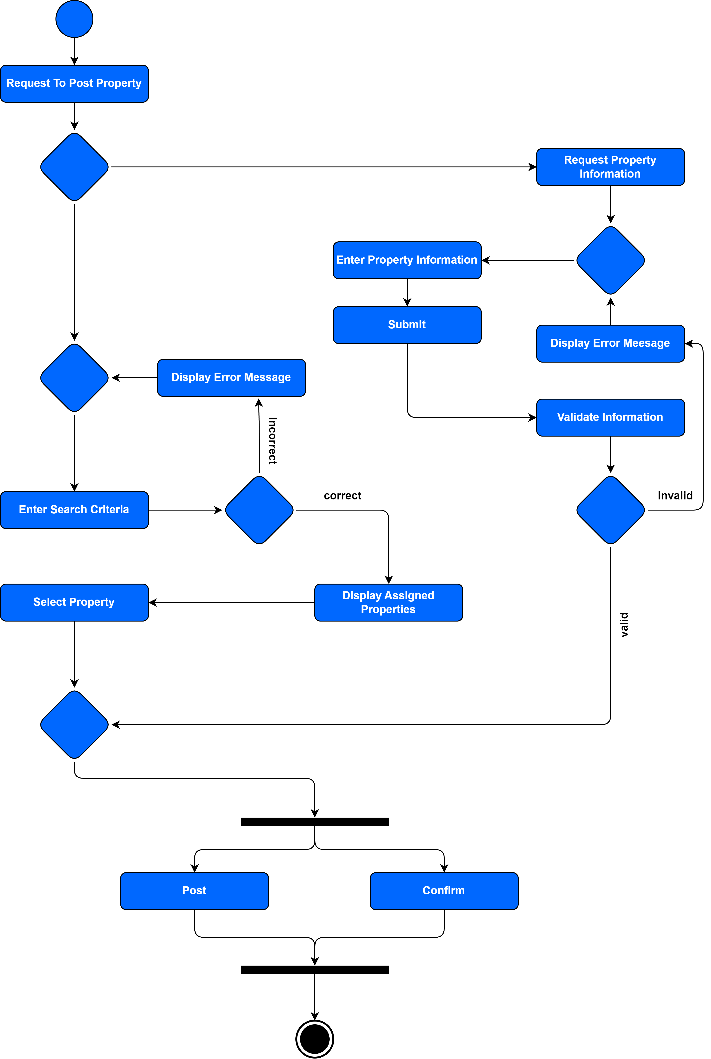
Activity Diagram
(Add Listing)

Slide 38
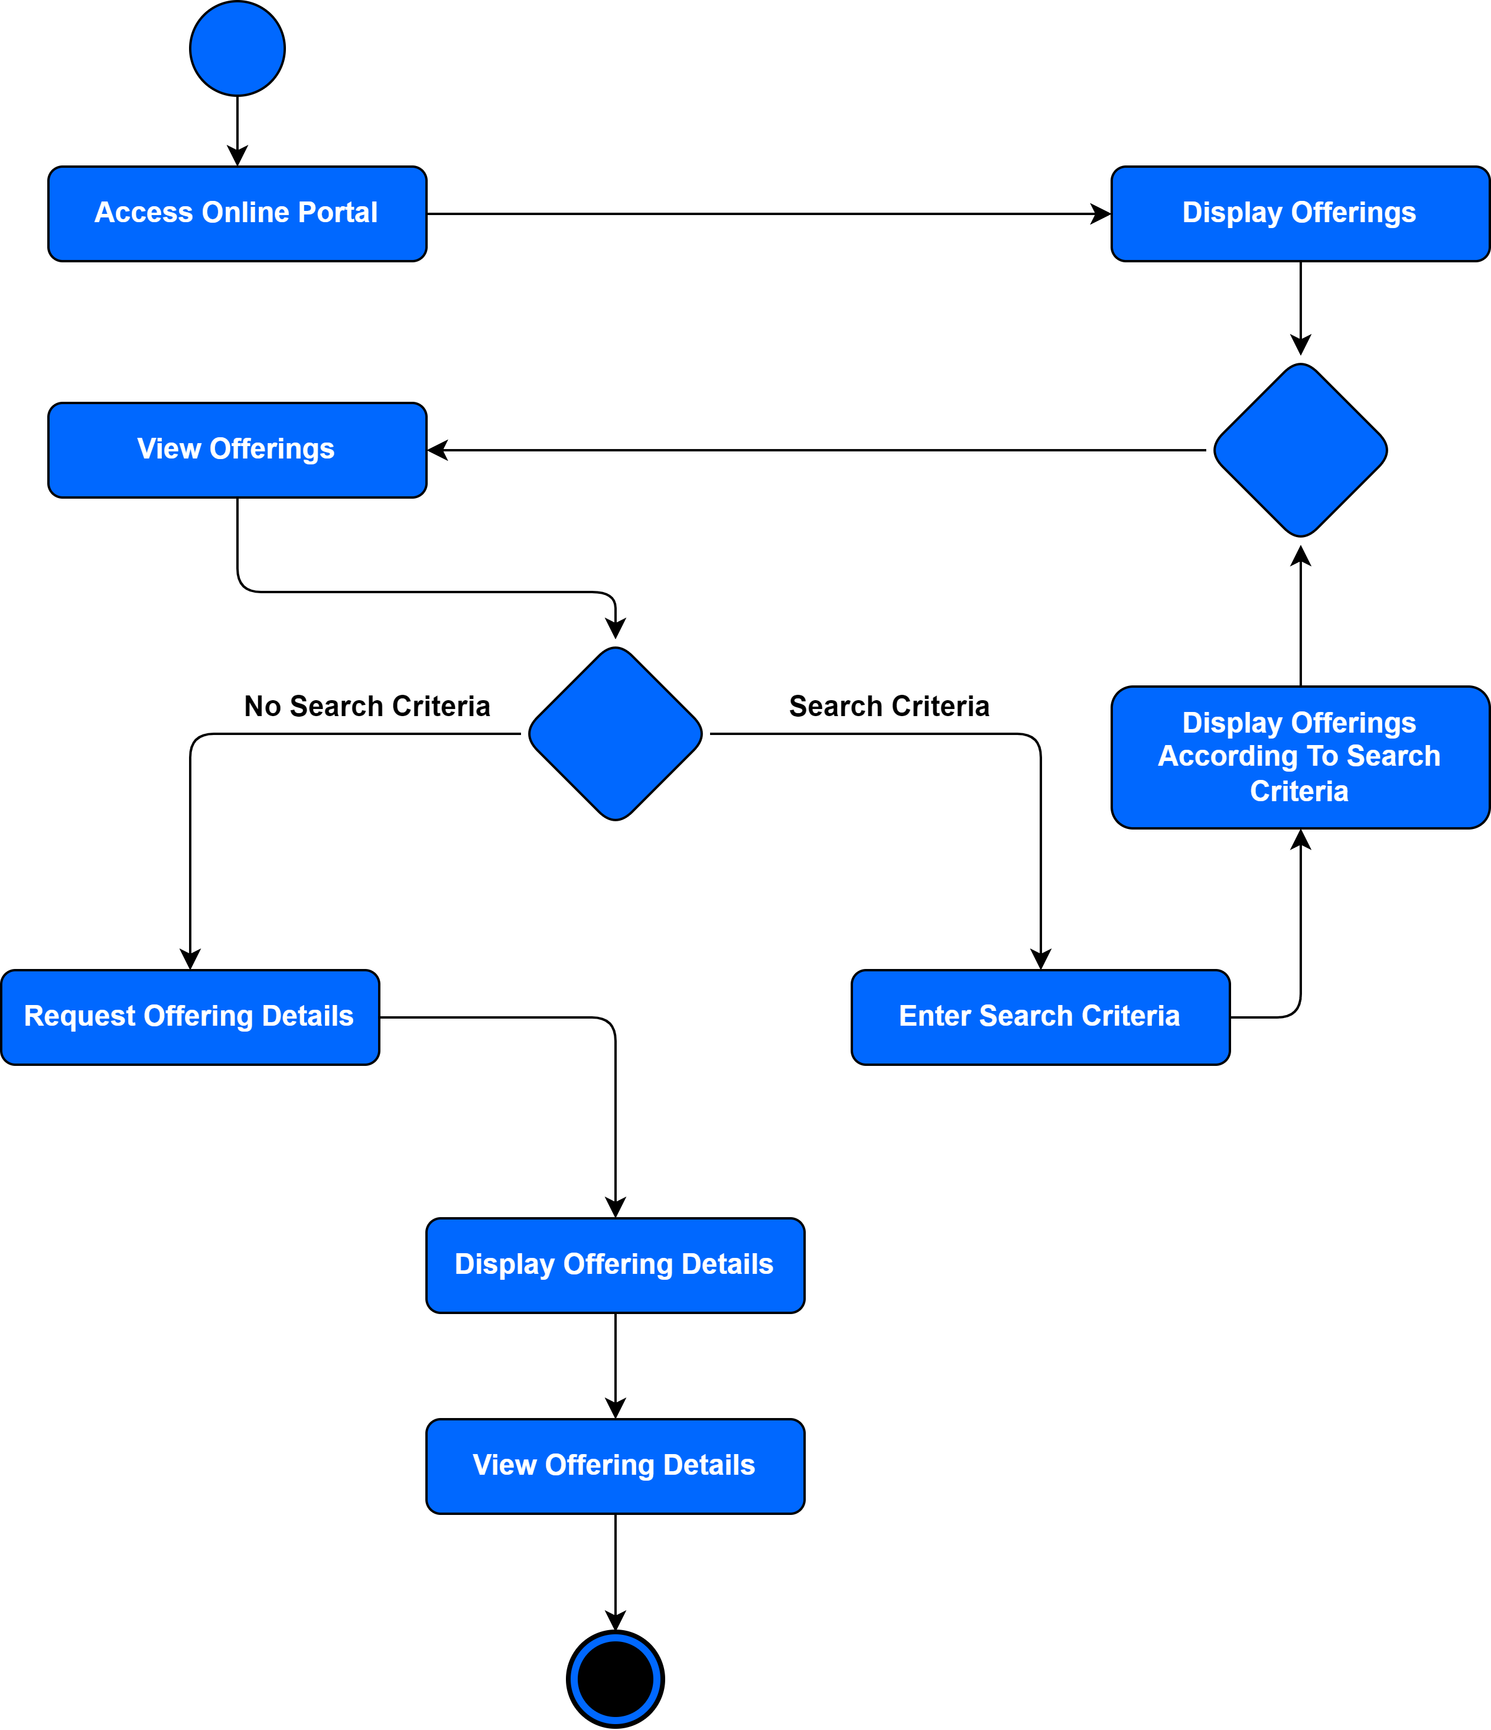
Activity Diagram
(View Offerings - Search Offerings - View an Offering Details)

Slide 39
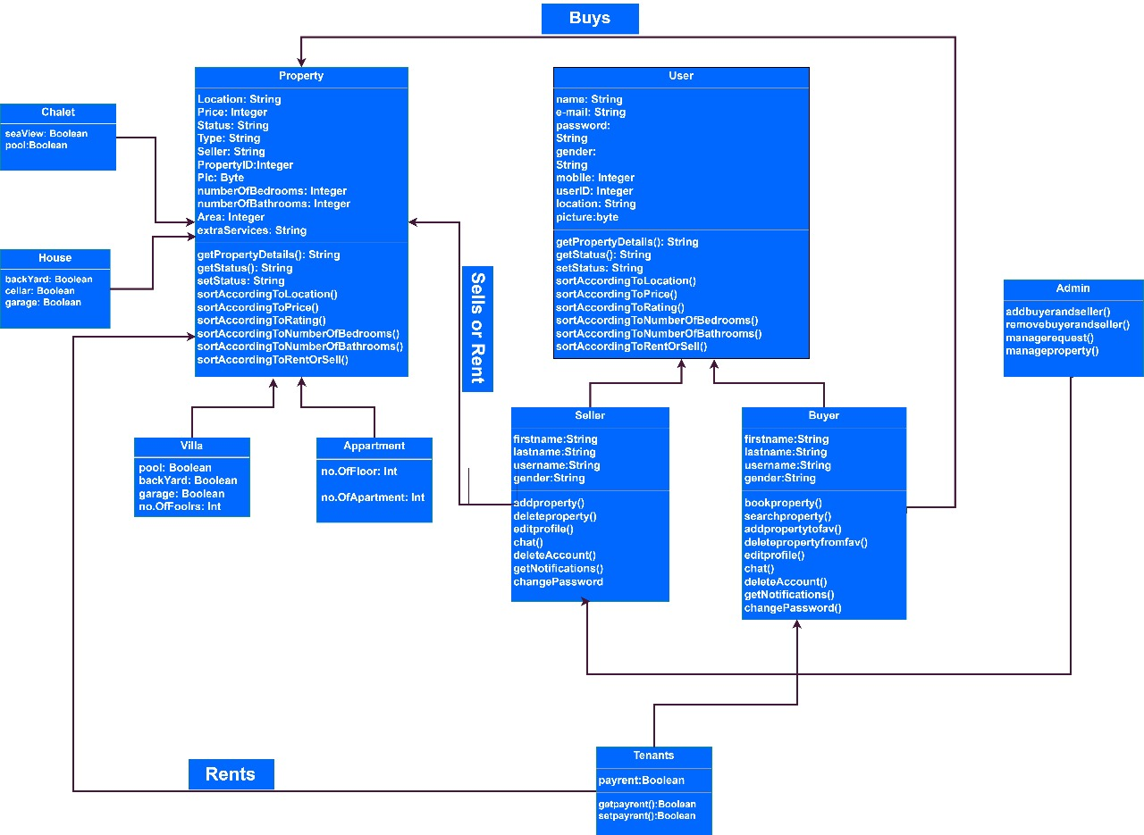
Class Diagram

Slide 40
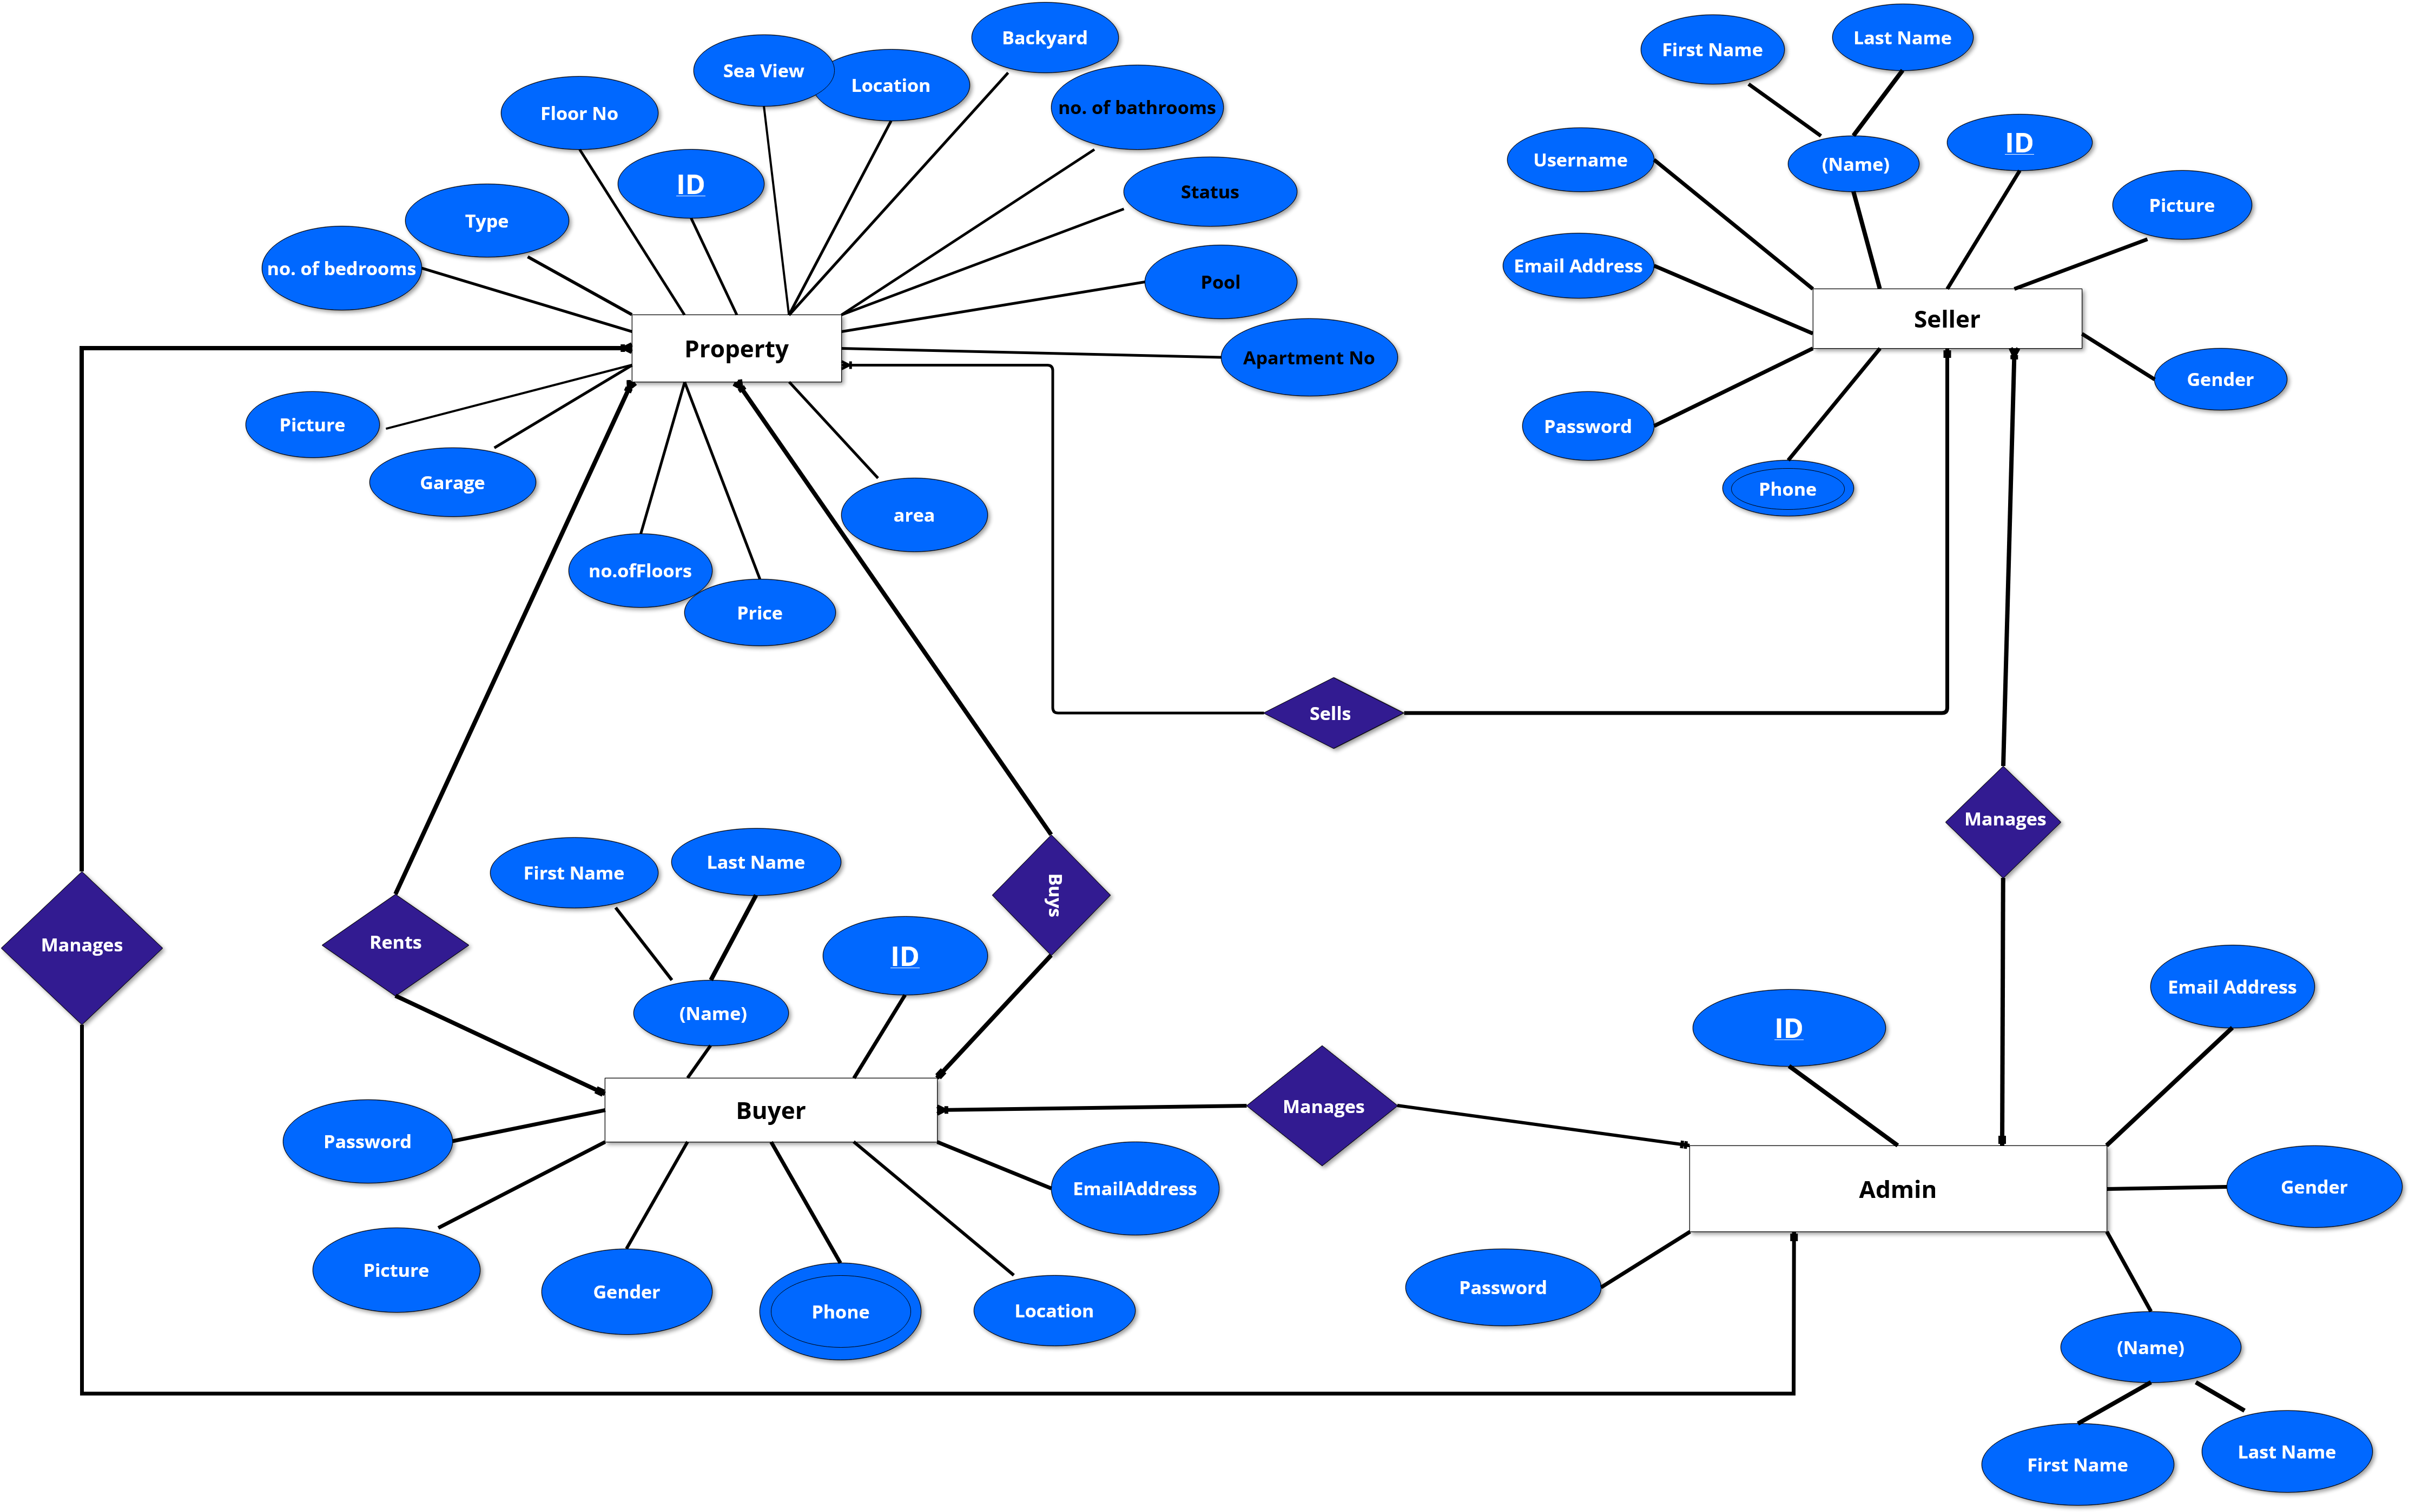
ERD

Slide 41




Mobile Application Design

Slide 42
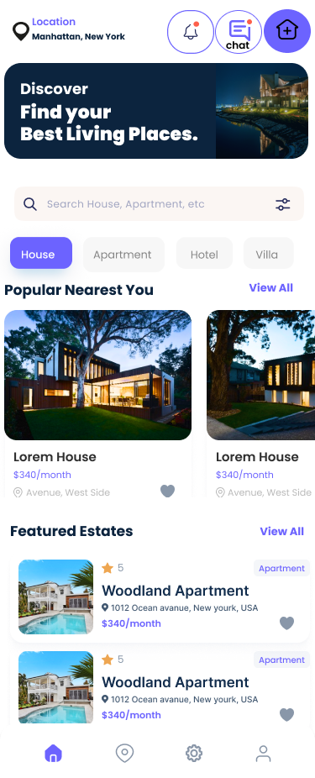
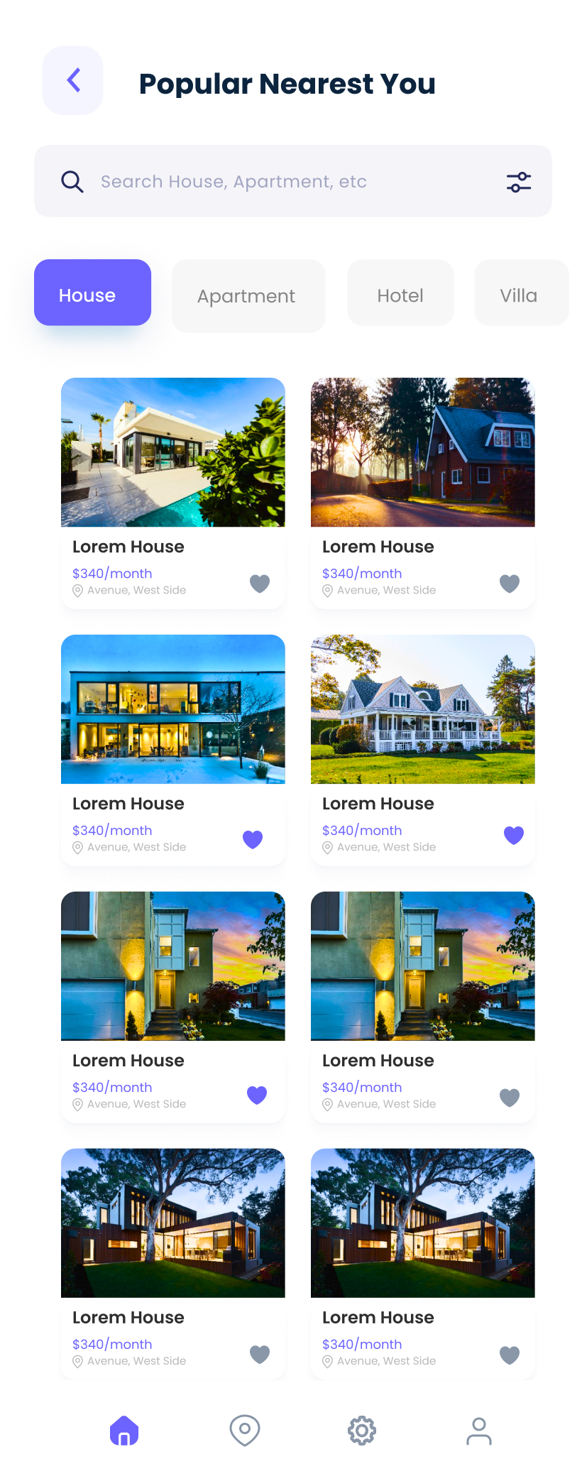
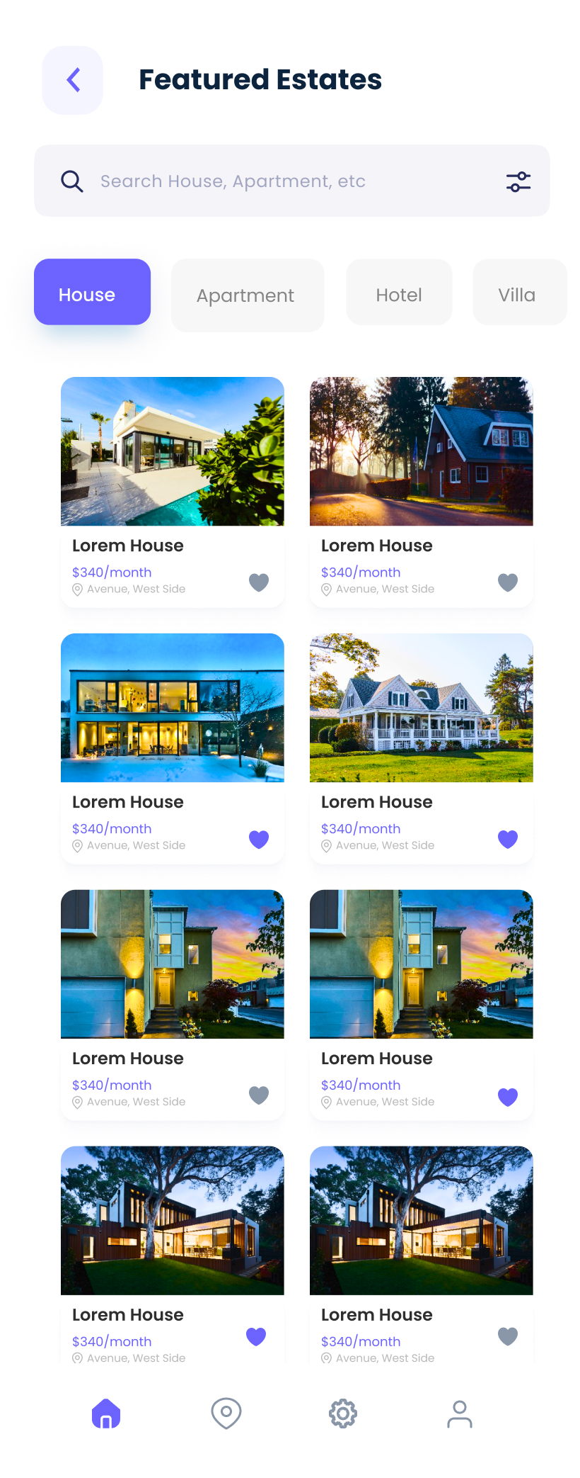
Mobile Application Design

Slide 43
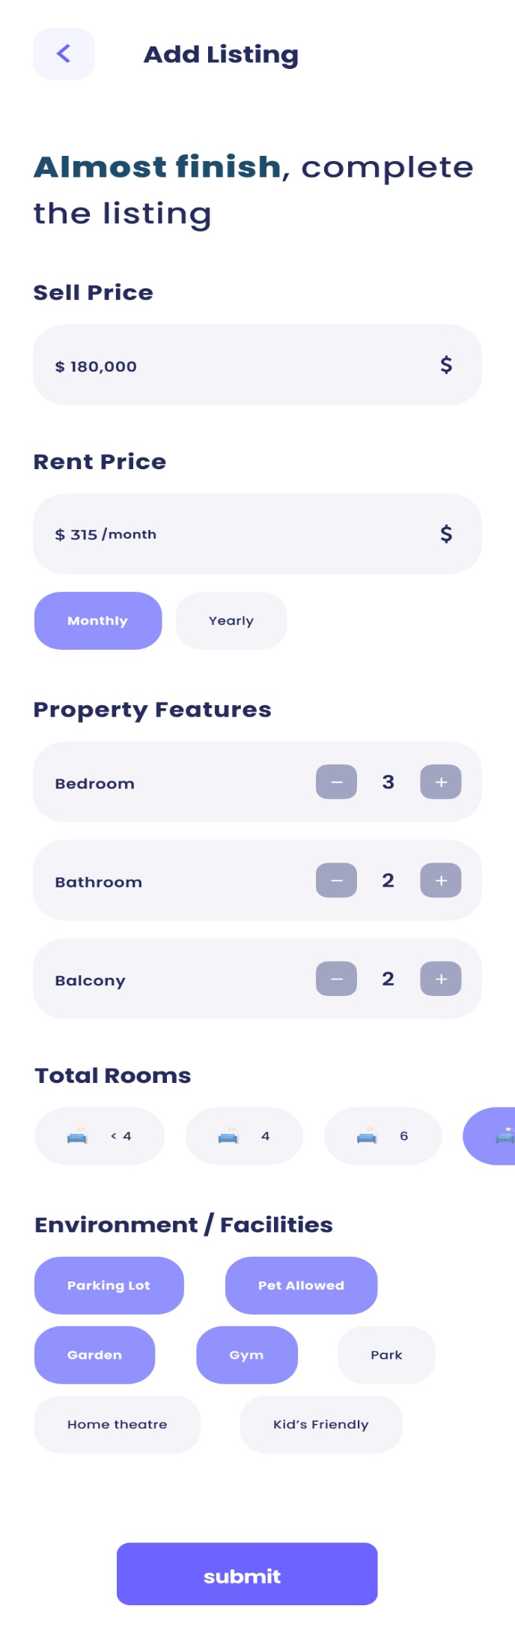
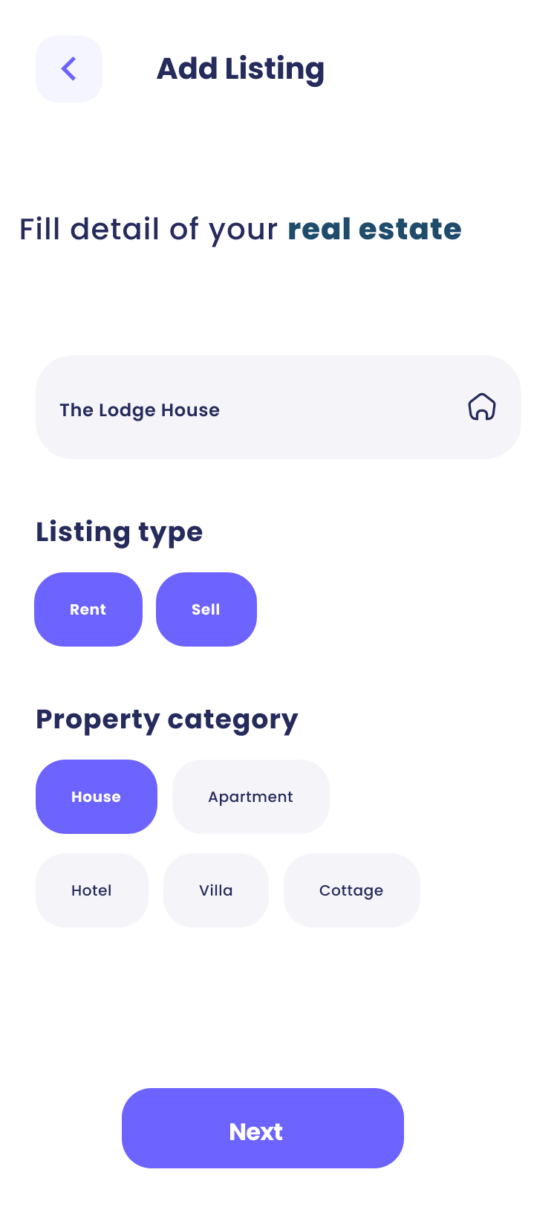
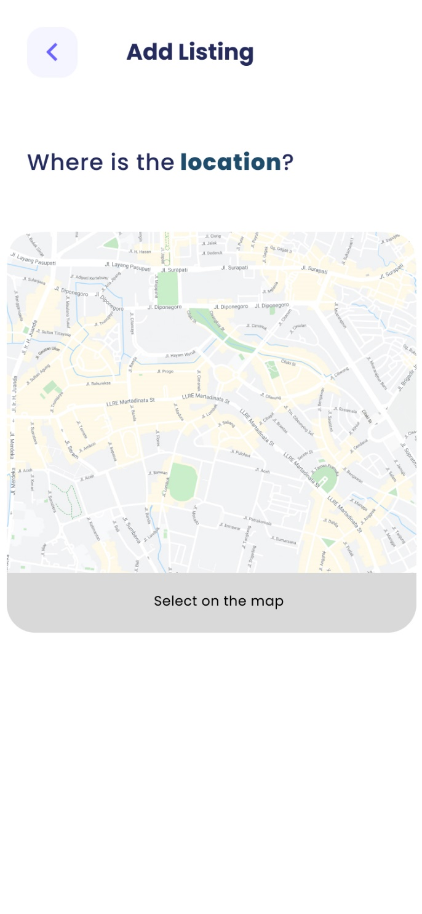
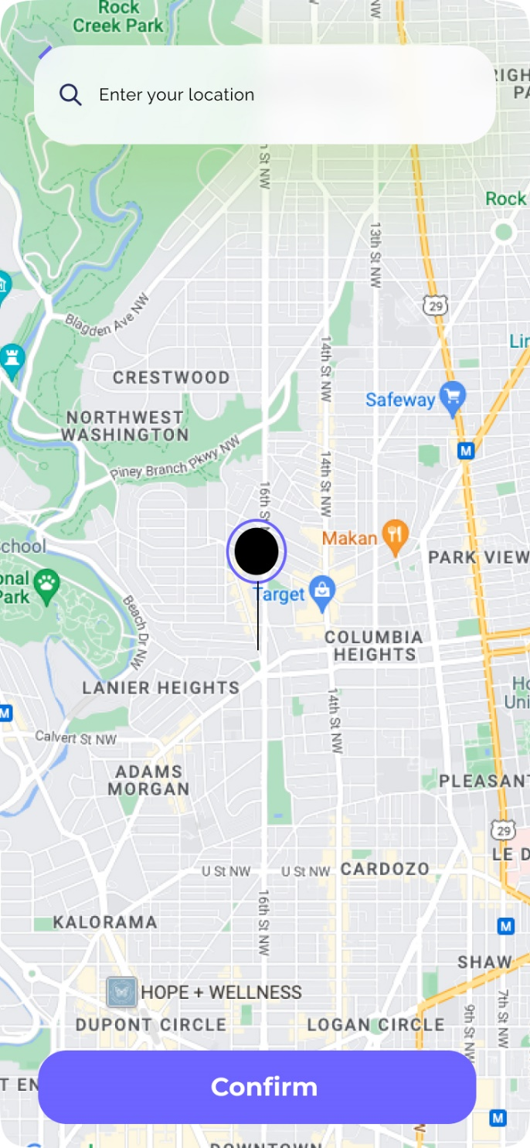
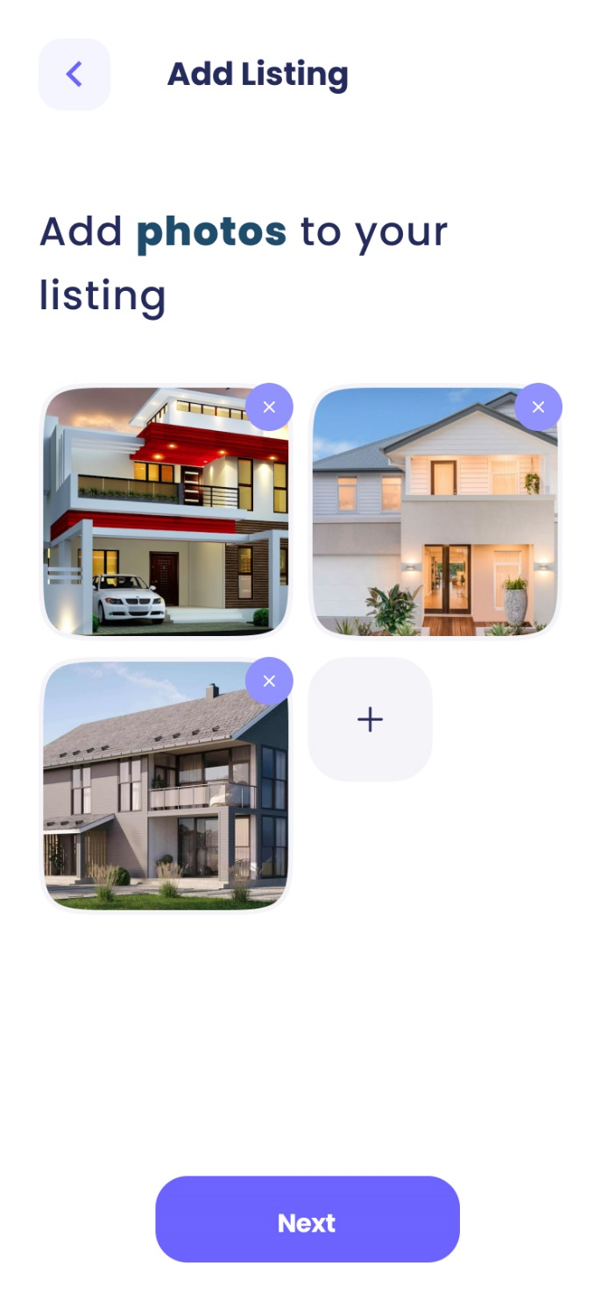

Mobile Application Design

Slide 44
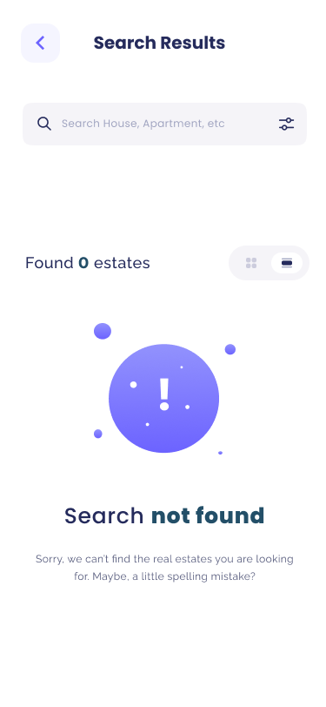
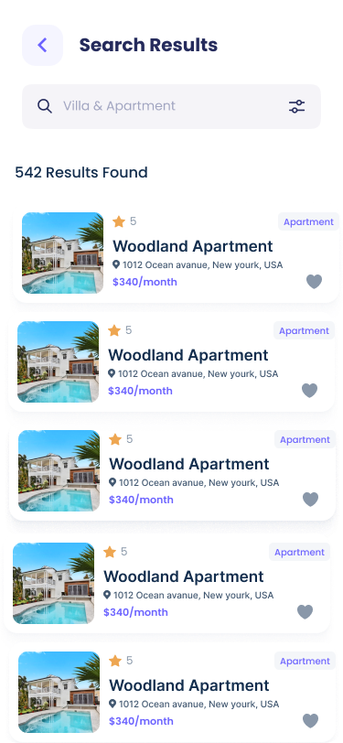
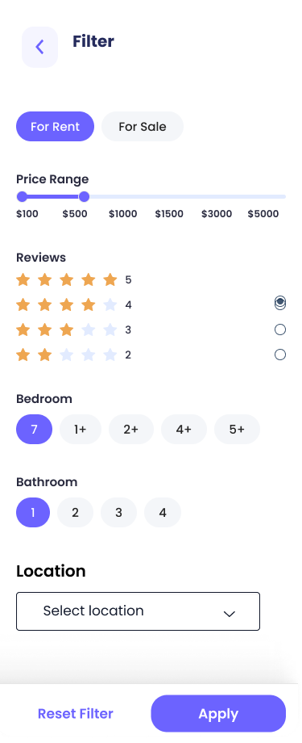
Mobile Application Design

Slide 45
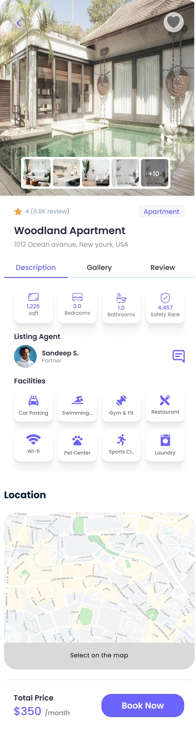


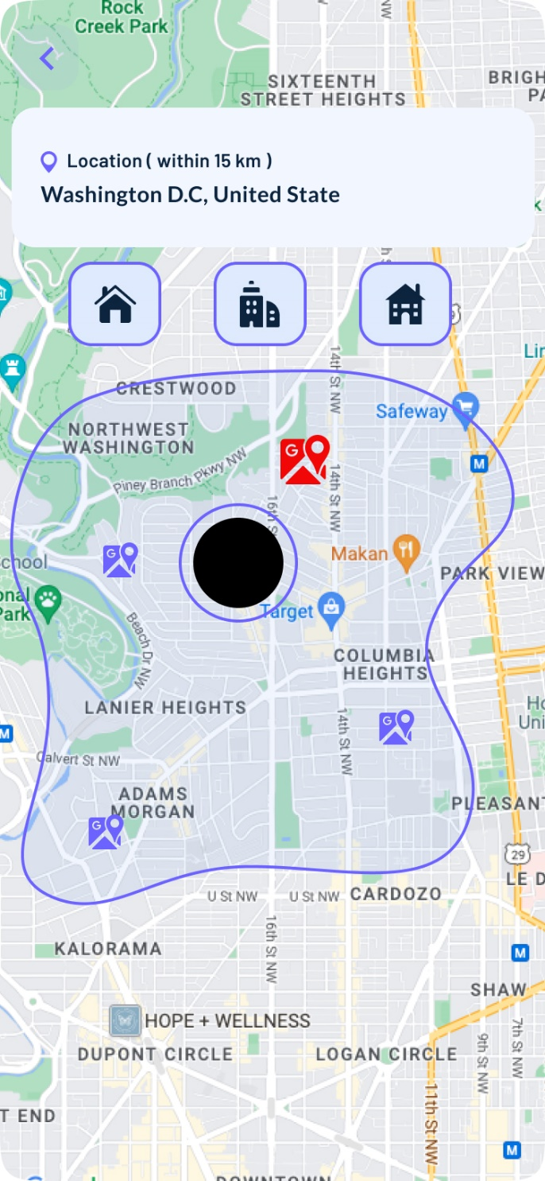

Mobile Application Design

Slide 46
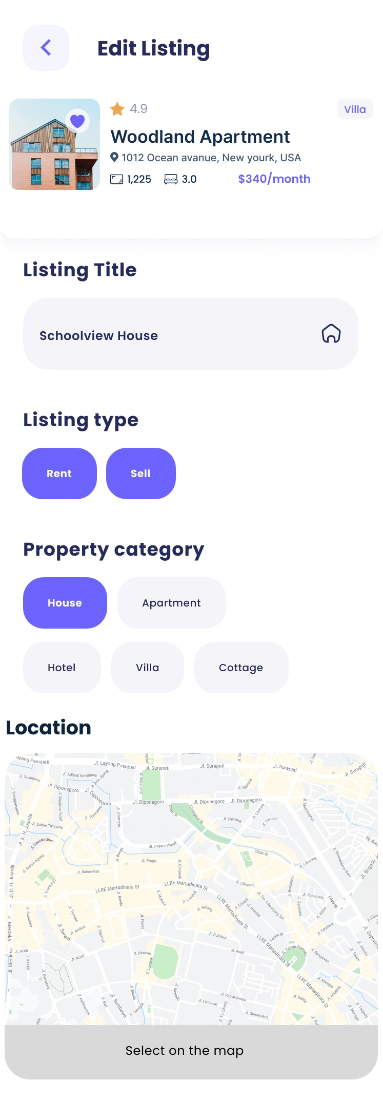
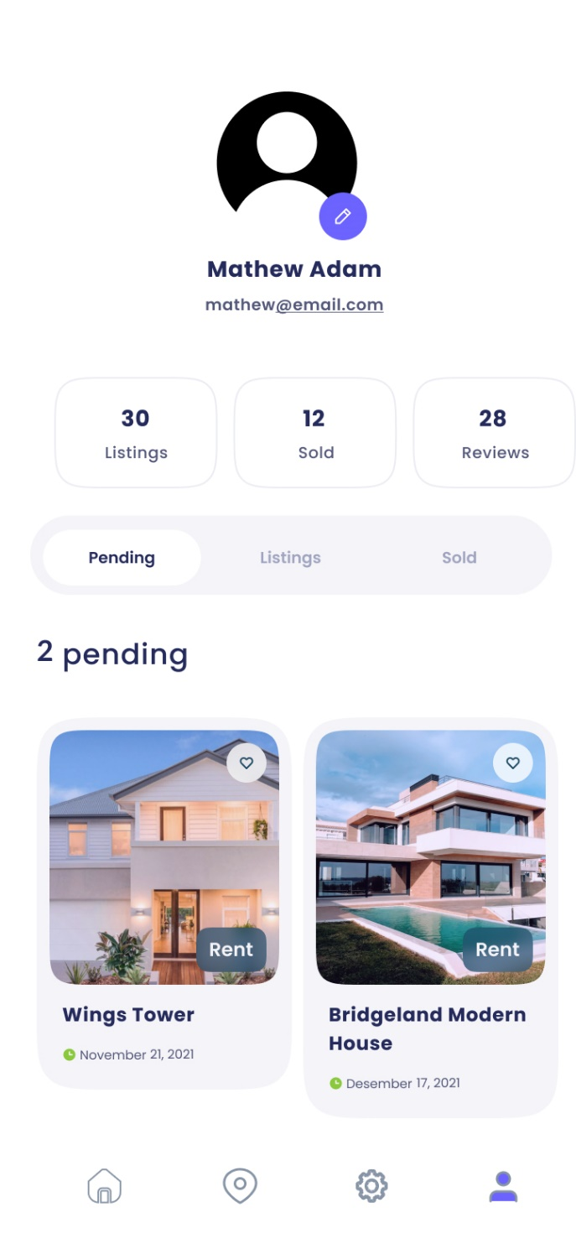
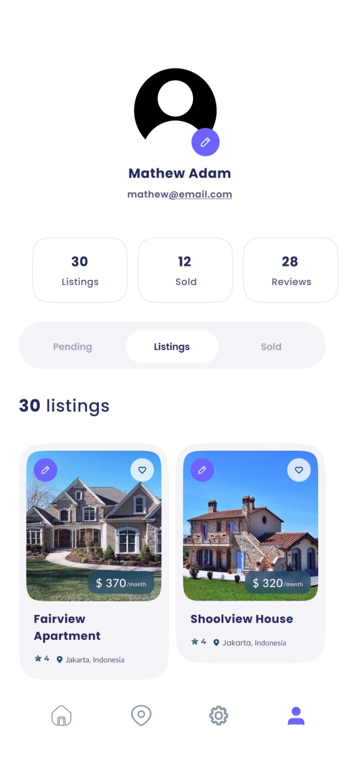



Mobile Application Design

Slide 47

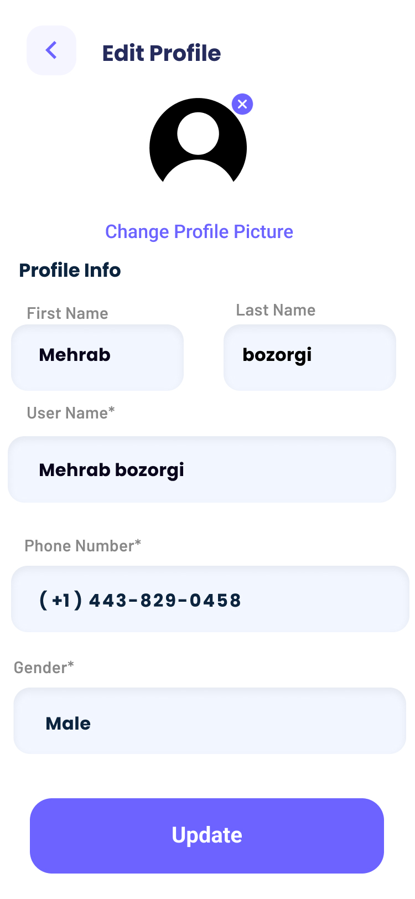

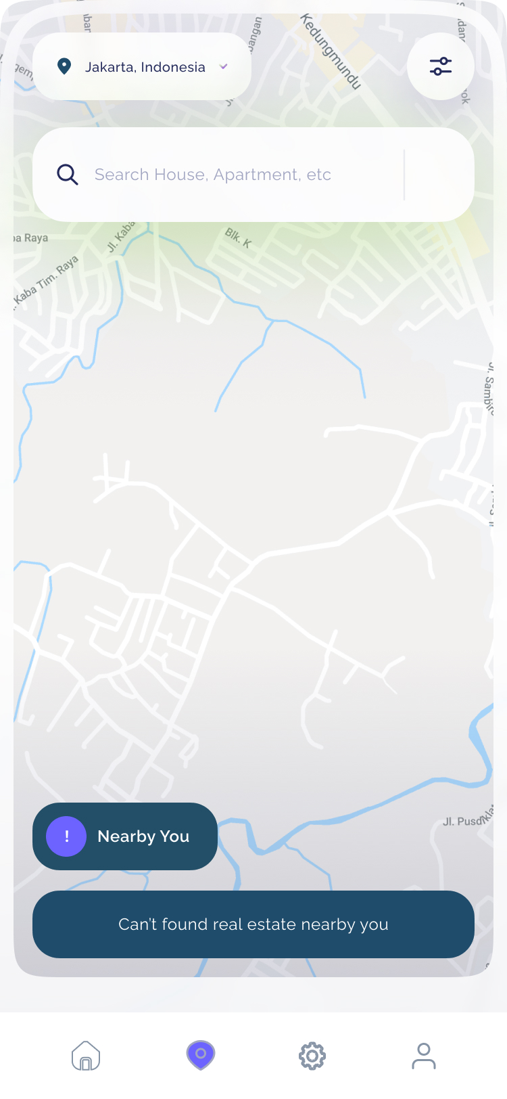
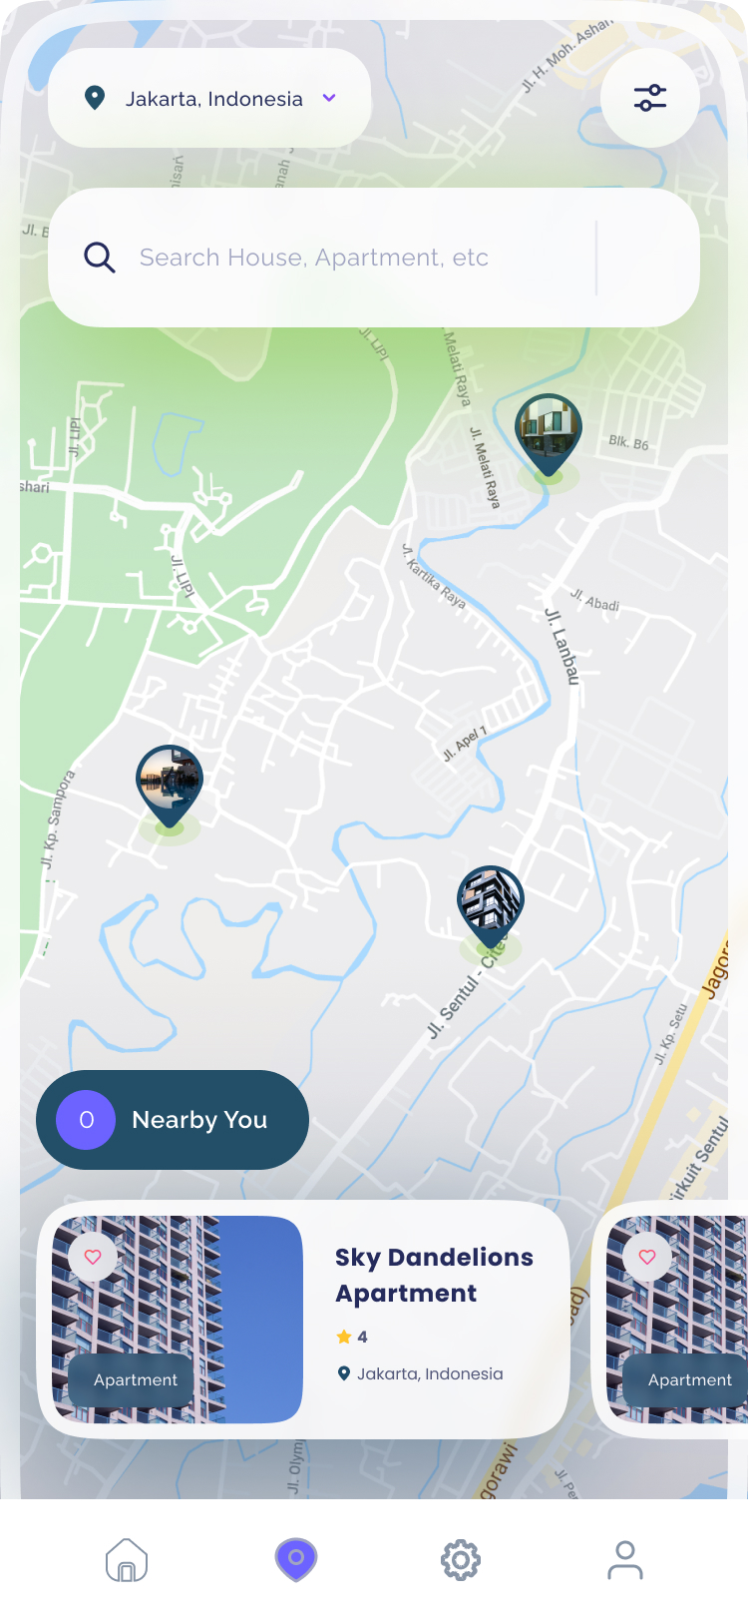
Mobile Application Design

Slide 48
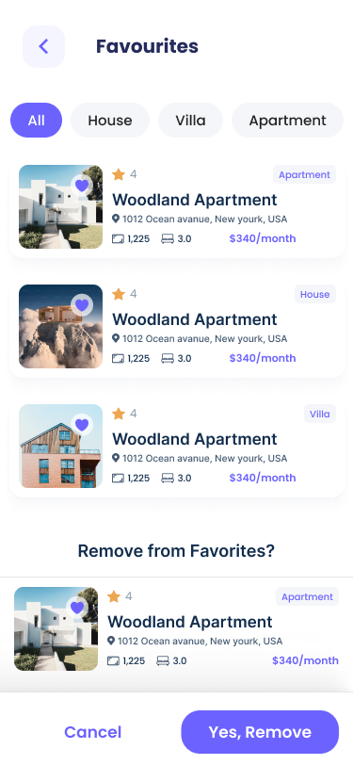

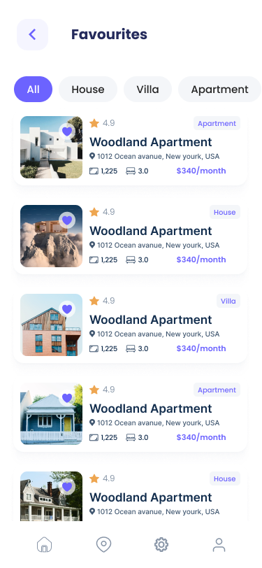
Mobile Application Design

Slide 49

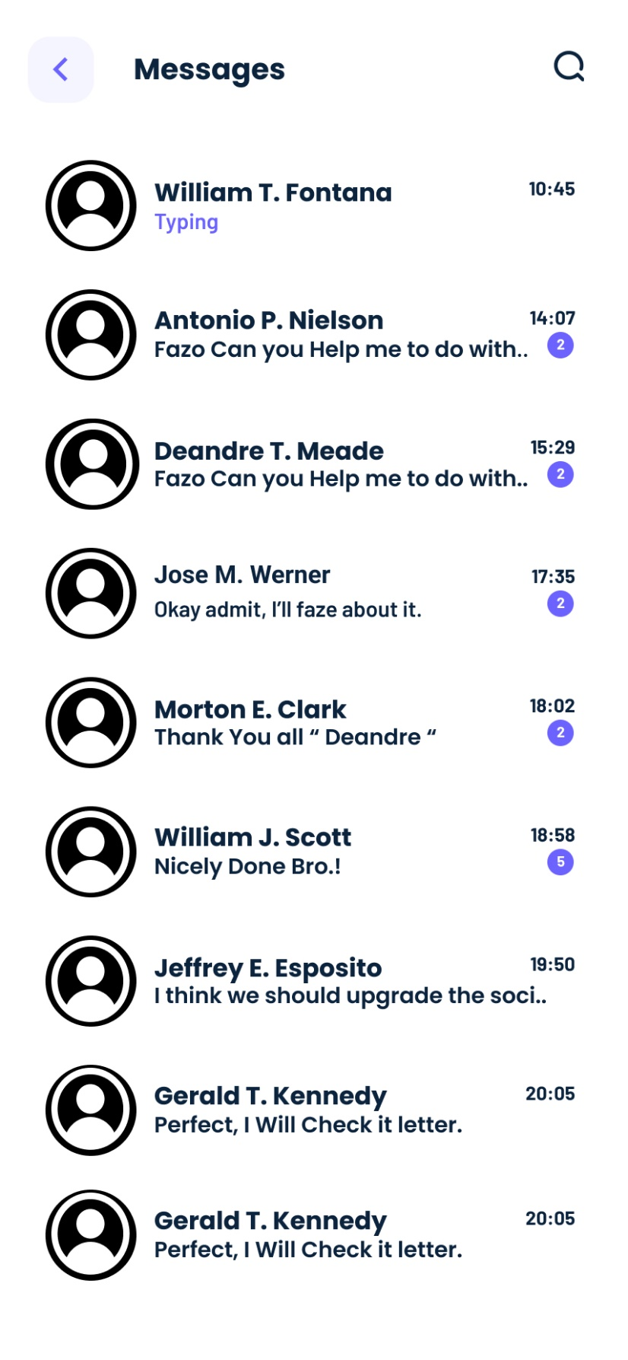
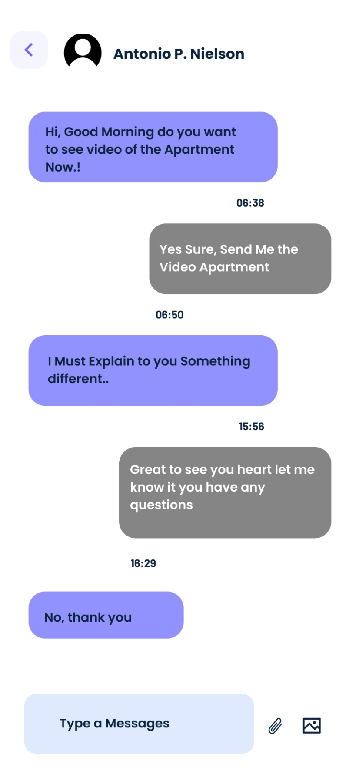
Mobile Application Design

Slide 50
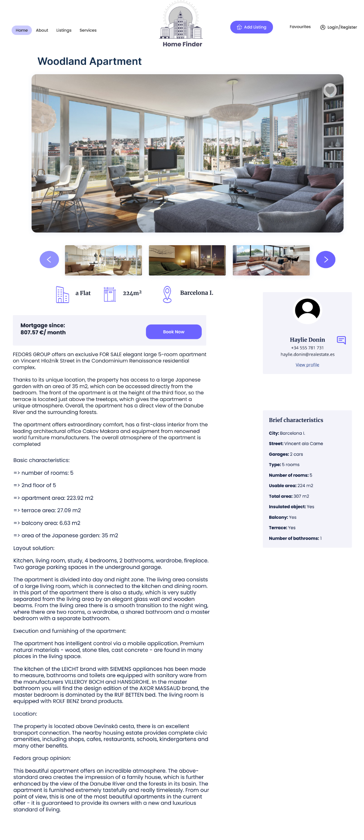


Web Application Design

Slide 51
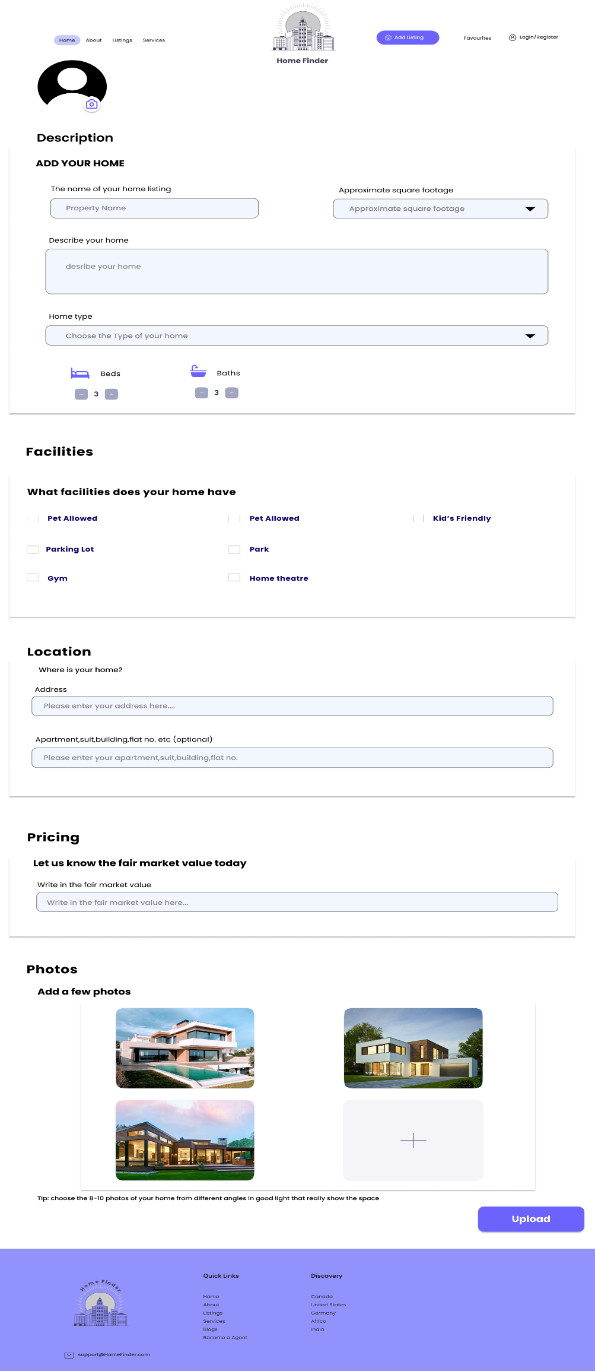



Web Application Design

Slide 52
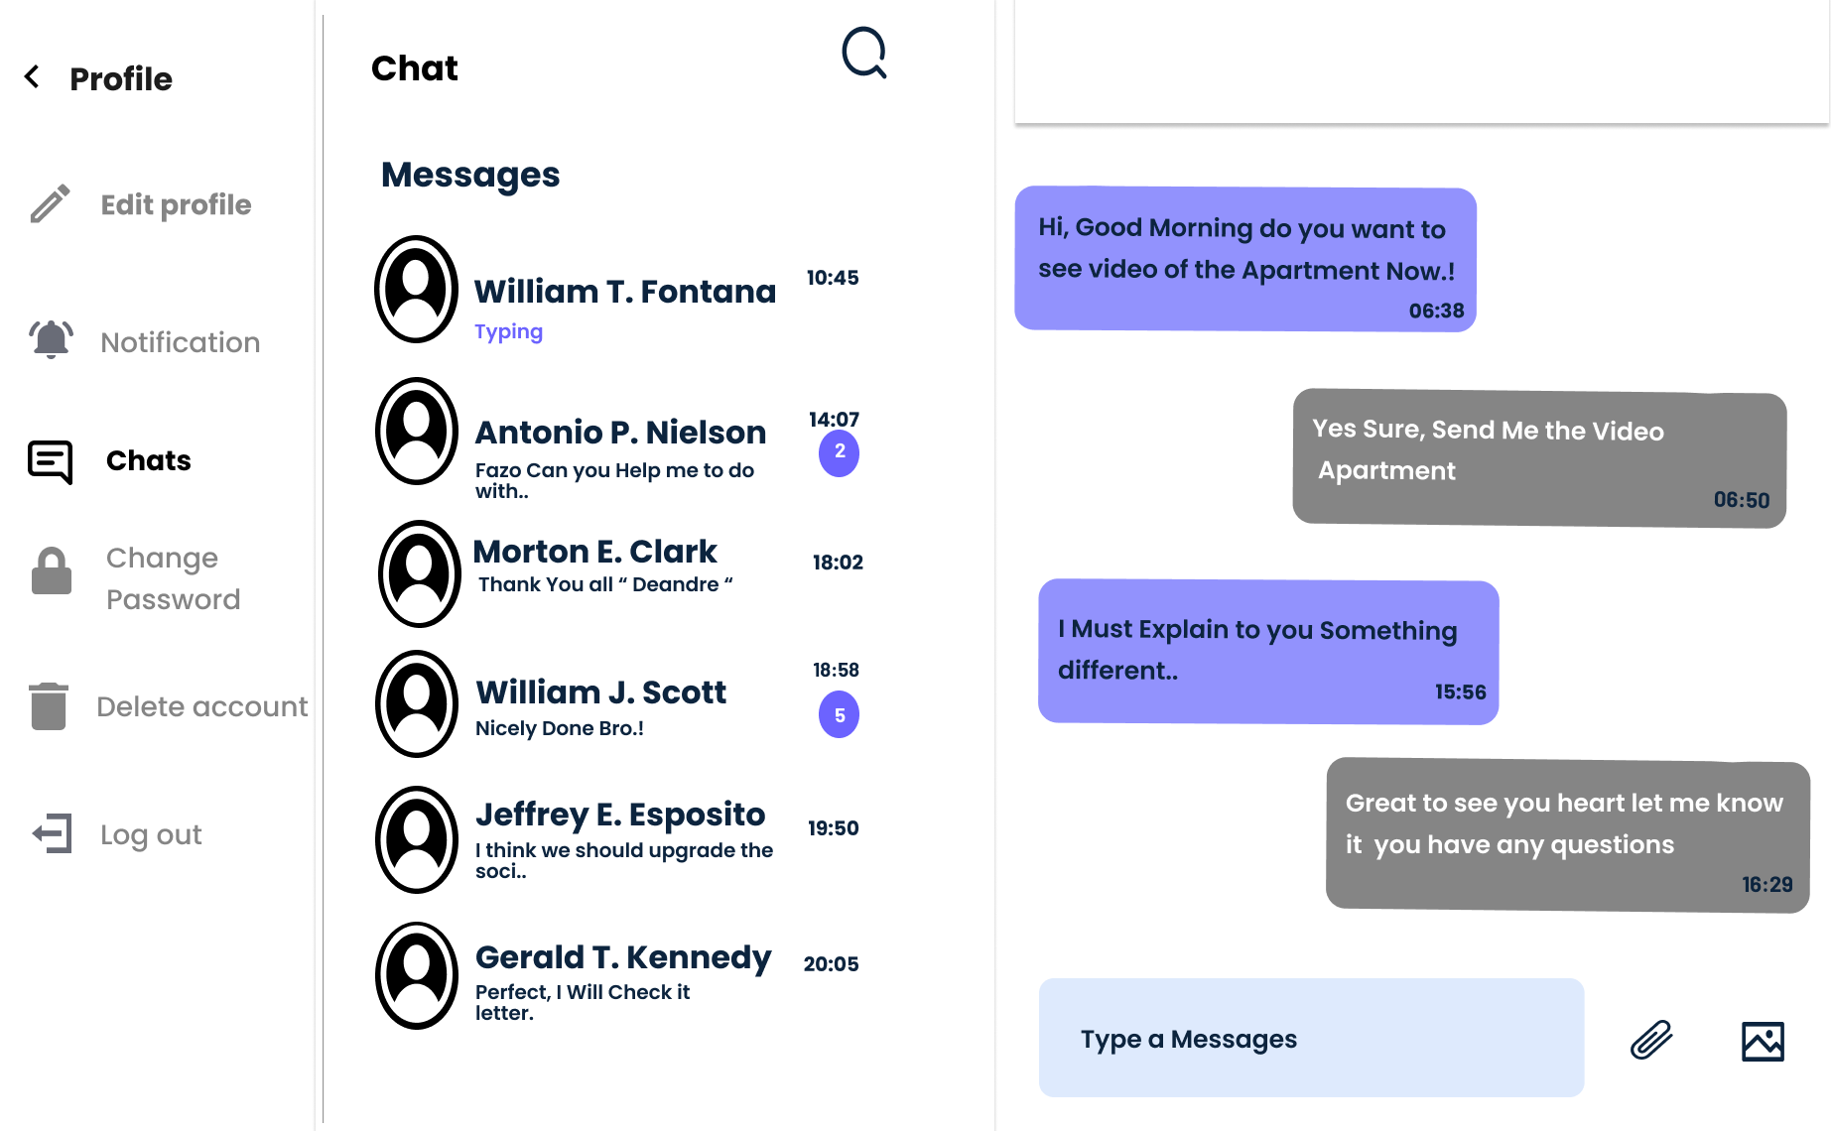
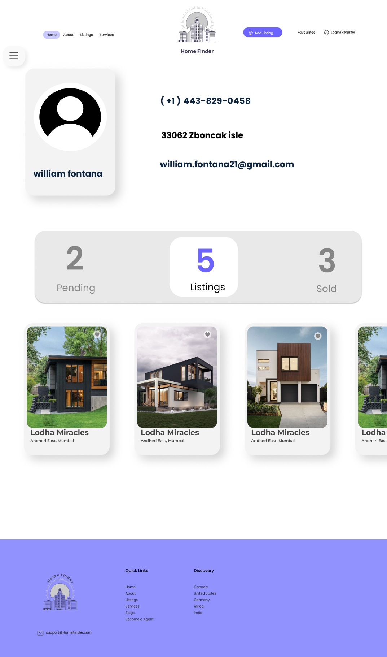

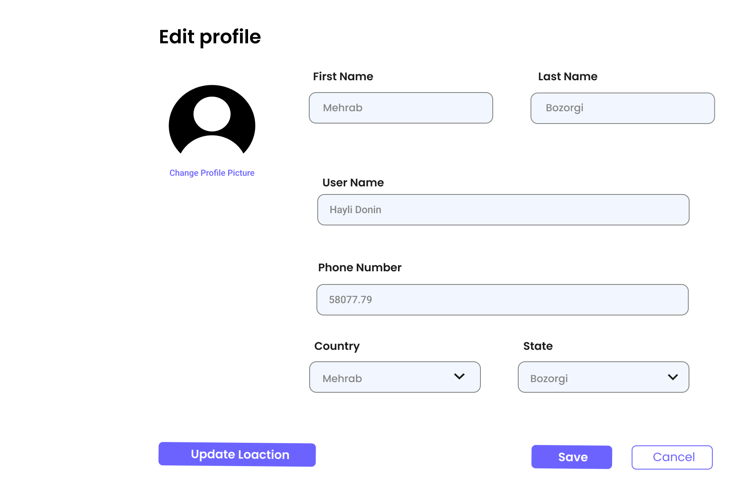
Web Application Design

Slide 53
Conclusion
Our Real Estate Website is aimed to revolutionize property transactions With advanced technology, user-friendly design, and innovative features, we provide a seamless platform for buyers and sellers to connect.
Also we pave the path towards a future where real estate are efficient and empowering

Slide 54
Future Work

Slide 55
Future Work
We will complete what we started to complete the project through many steps in Design , Front-end , Back-end and Machine Learning :
Design
Front-End
we will add Admin Panel with full access to adding and deleting properties and having the ability to approve what users add to ensure credibility and security.
We will complete implementing UI and API’s and machine learning models.

Slide 56
Future Work
We will complete what we started to complete the project through many steps in Design , Front-end , Back-end and Machine Learning :
Back-End
Machine Learning
We will complete our database to provide all real estate data to be linked with front-end and the model of machine learning.
We will complete testing and training the model to get an accurate results and creating recommendation system.

Slide 57
References

Slide 58
Questions & Suggestions

Slide 59
Thank you

